Slide 1
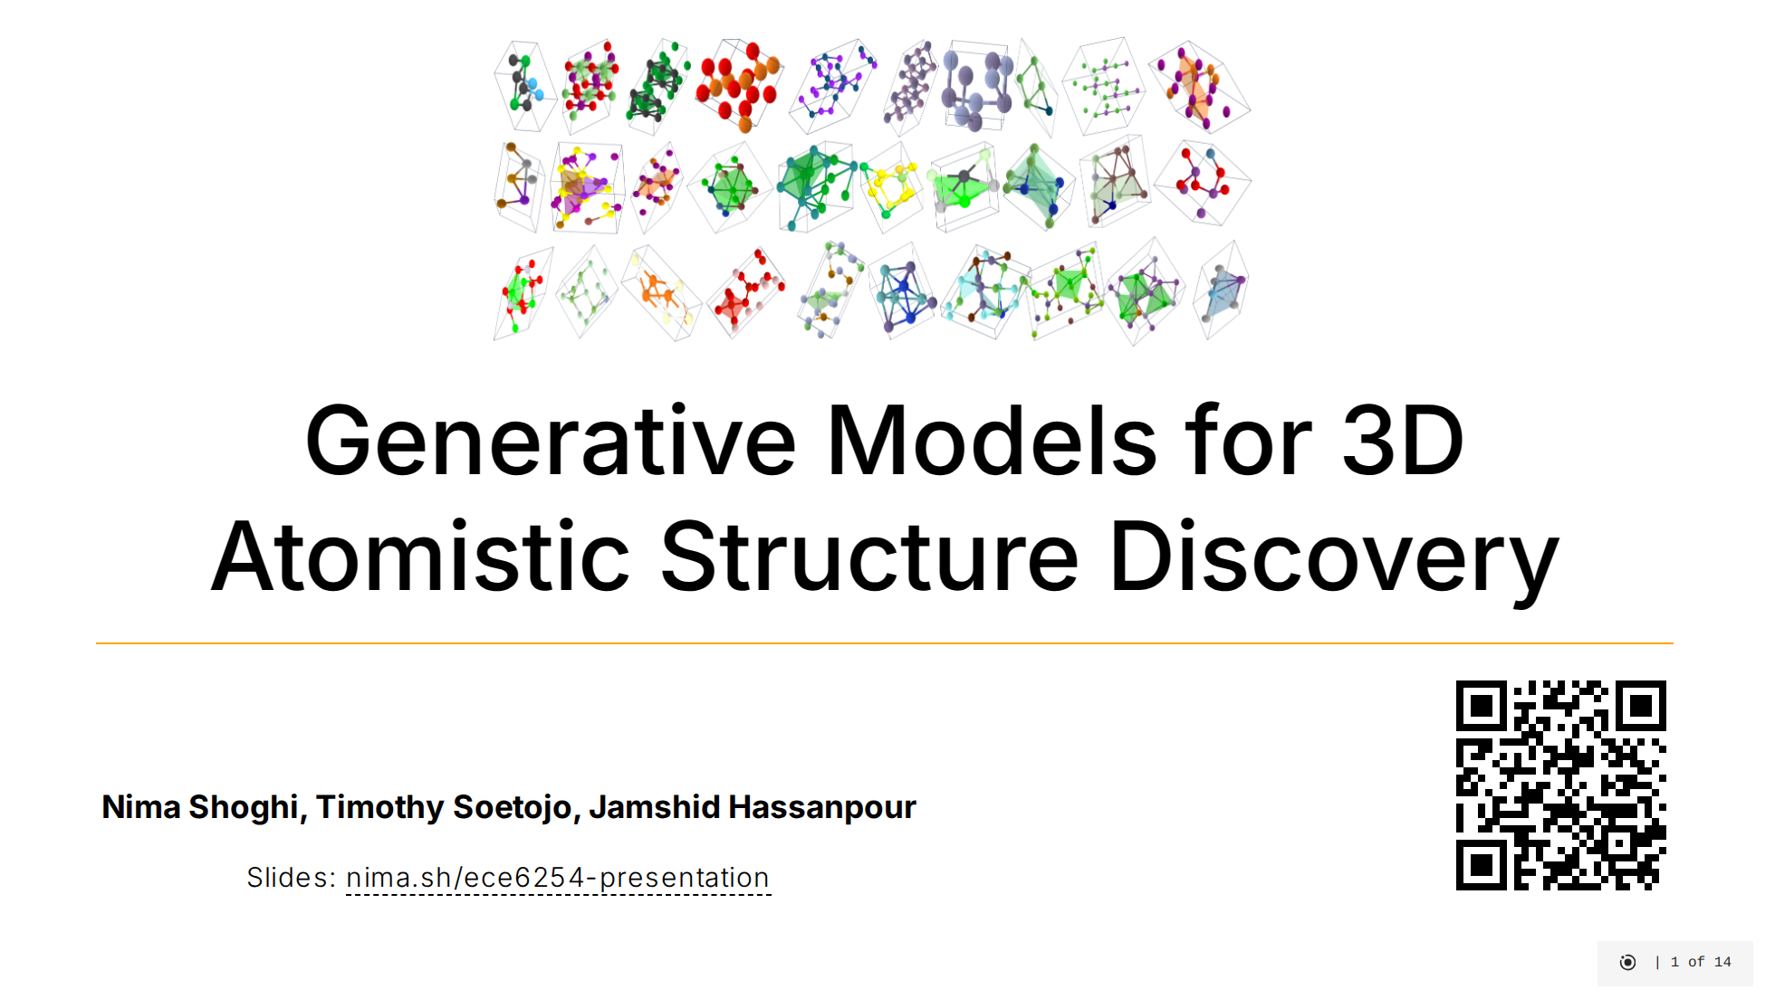
Notes:
Good afternoon everyone. Today we're presenting our project on generative models for 3D atomistic structure discovery. This project explores how we can use AI to discover new materials by generating stable 3D atomic structures. Our work compares several cutting-edge deep learning approaches for this challenging task. We'll walk you through why this problem matters, our approach to solving it, and what we discovered from our experiments.

Slide 2
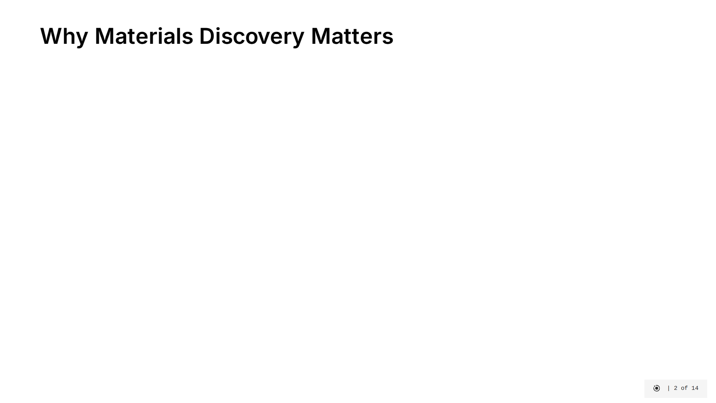
Notes:
Let's understand why materials discovery is so important and challenging. [click] Every technology we rely on - from smartphones to solar panels - starts with a material discovery. But traditionally, bringing a new material from lab discovery to market application takes over 20 years. This slow cycle limits technological progress. [click] The challenge is finding viable materials in an astronomically large search space. There are approximately 10²⁰ possible inorganic materials, but only about 1 in 100,000 structures are chemically stable enough to synthesize. Finding these rare stable structures manually is like finding a needle in a cosmic-sized haystack. [click] This is where generative machine learning becomes our "virtual lab." By training AI on databases of known stable materials, we can generate novel candidates that have a much higher probability of stability. This approach could revolutionize how we discover materials for critical applications like next-generation batteries, carbon capture technologies, and targeted drug delivery systems. [click] The image on the right shows a visualization of a crystal structure. Our project specifically compares different state-of-the-art generative methods to determine which approaches best capture the physical constraints that make materials stable in the real world.

Slide 3
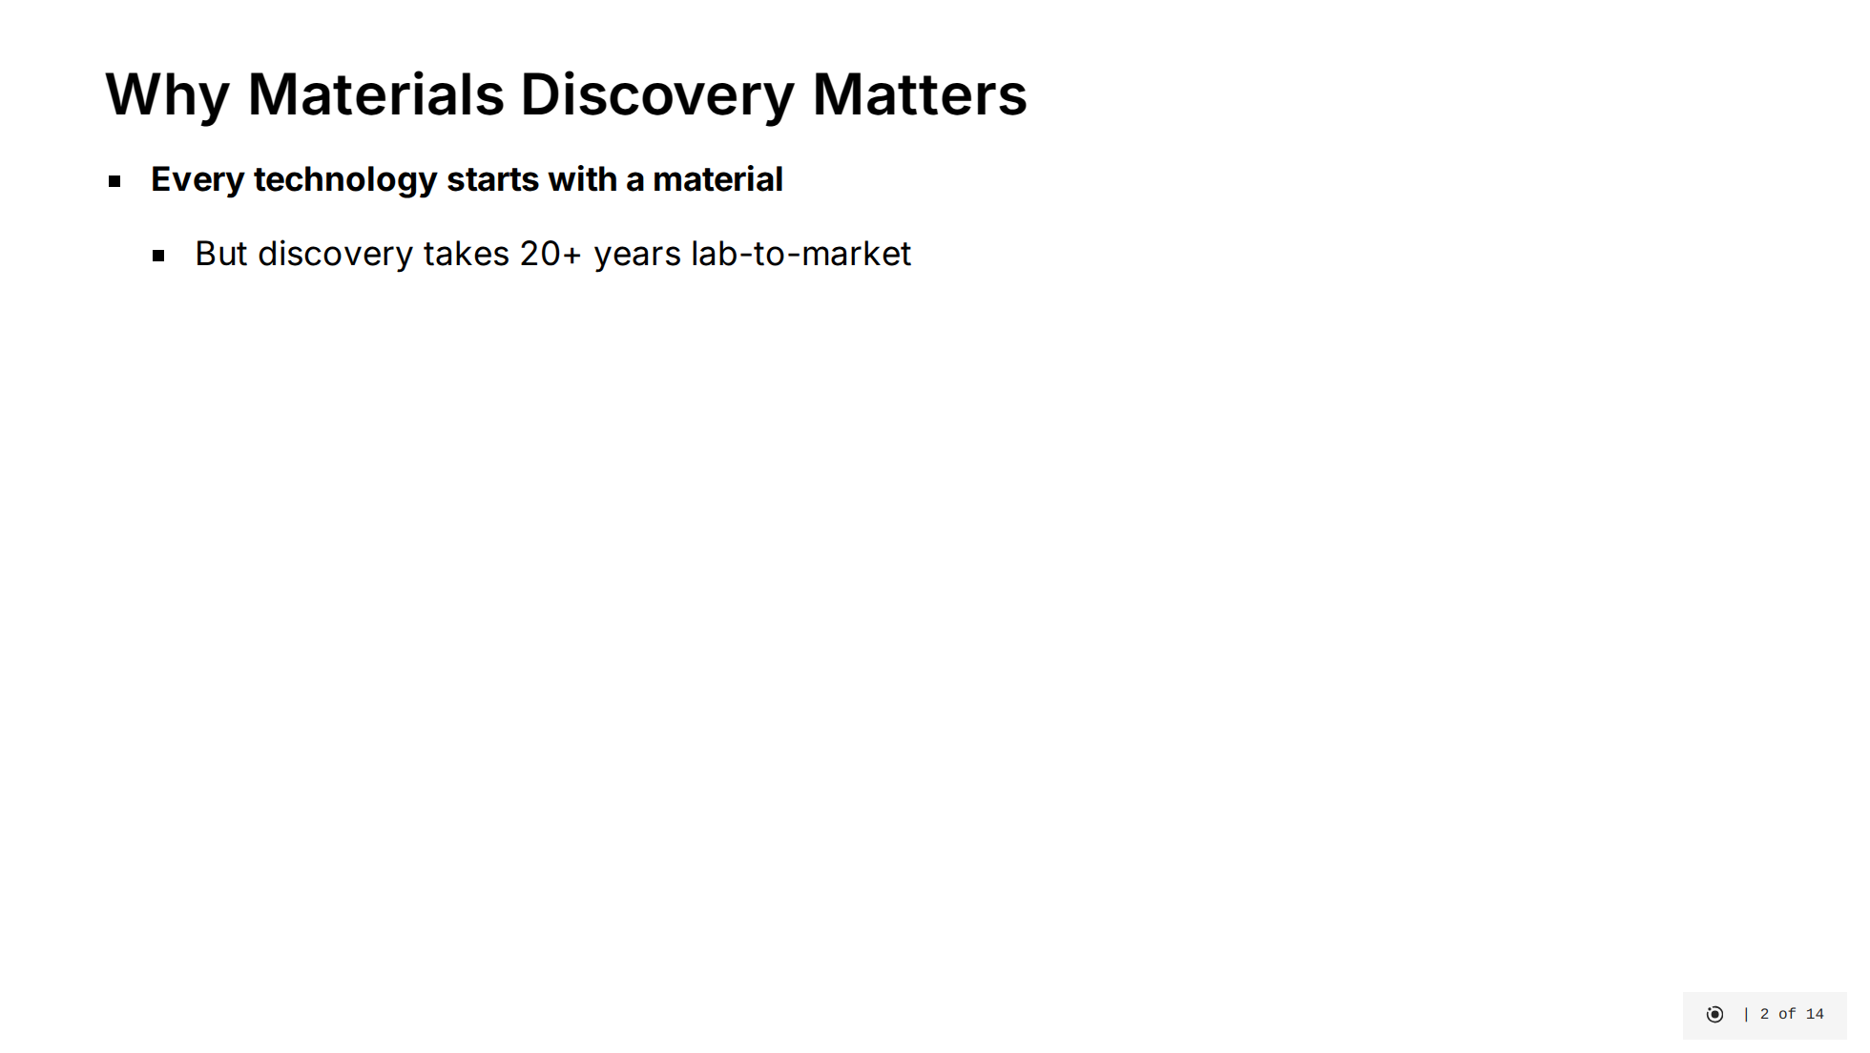
Notes:
Let's understand why materials discovery is so important and challenging. [click] Every technology we rely on - from smartphones to solar panels - starts with a material discovery. But traditionally, bringing a new material from lab discovery to market application takes over 20 years. This slow cycle limits technological progress. [click] The challenge is finding viable materials in an astronomically large search space. There are approximately 10²⁰ possible inorganic materials, but only about 1 in 100,000 structures are chemically stable enough to synthesize. Finding these rare stable structures manually is like finding a needle in a cosmic-sized haystack. [click] This is where generative machine learning becomes our "virtual lab." By training AI on databases of known stable materials, we can generate novel candidates that have a much higher probability of stability. This approach could revolutionize how we discover materials for critical applications like next-generation batteries, carbon capture technologies, and targeted drug delivery systems. [click] The image on the right shows a visualization of a crystal structure. Our project specifically compares different state-of-the-art generative methods to determine which approaches best capture the physical constraints that make materials stable in the real world.

Slide 4
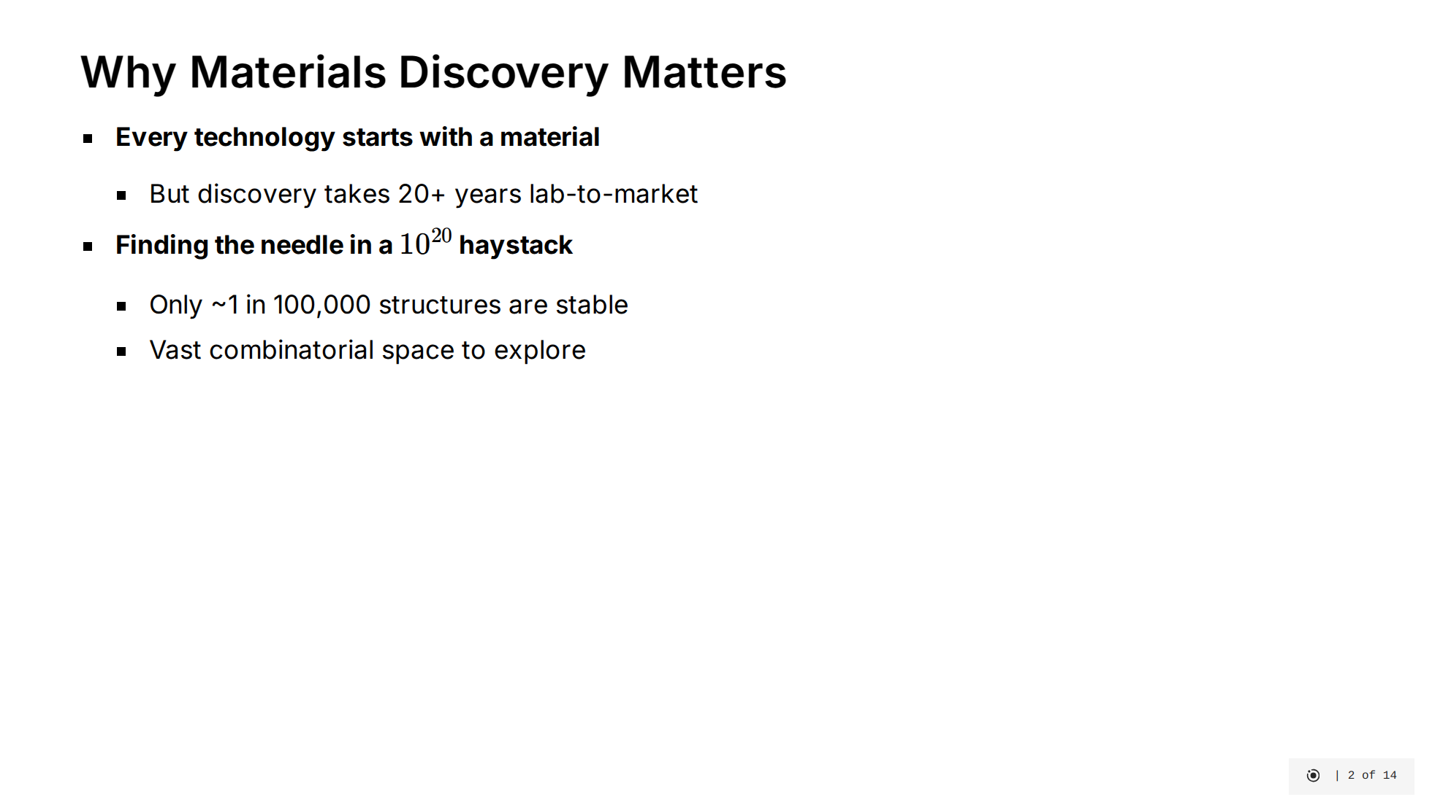
Notes:
Let's understand why materials discovery is so important and challenging. [click] Every technology we rely on - from smartphones to solar panels - starts with a material discovery. But traditionally, bringing a new material from lab discovery to market application takes over 20 years. This slow cycle limits technological progress. [click] The challenge is finding viable materials in an astronomically large search space. There are approximately 10²⁰ possible inorganic materials, but only about 1 in 100,000 structures are chemically stable enough to synthesize. Finding these rare stable structures manually is like finding a needle in a cosmic-sized haystack. [click] This is where generative machine learning becomes our "virtual lab." By training AI on databases of known stable materials, we can generate novel candidates that have a much higher probability of stability. This approach could revolutionize how we discover materials for critical applications like next-generation batteries, carbon capture technologies, and targeted drug delivery systems. [click] The image on the right shows a visualization of a crystal structure. Our project specifically compares different state-of-the-art generative methods to determine which approaches best capture the physical constraints that make materials stable in the real world.

Slide 5
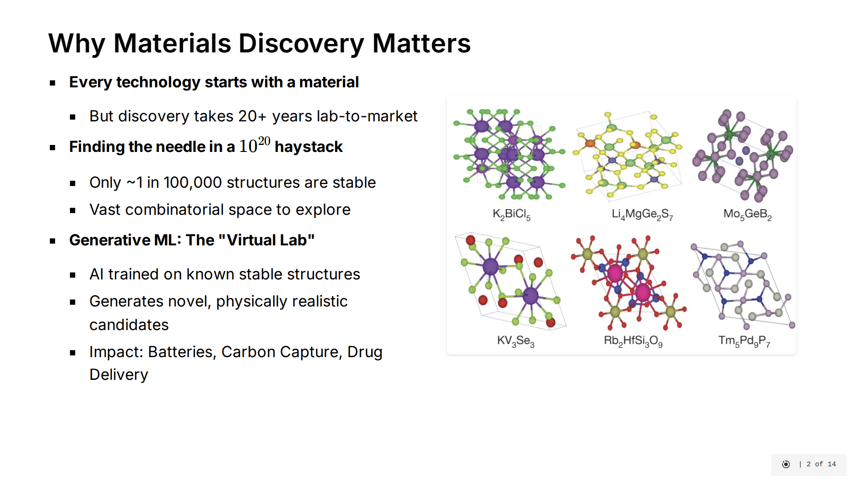
Notes:
Let's understand why materials discovery is so important and challenging. [click] Every technology we rely on - from smartphones to solar panels - starts with a material discovery. But traditionally, bringing a new material from lab discovery to market application takes over 20 years. This slow cycle limits technological progress. [click] The challenge is finding viable materials in an astronomically large search space. There are approximately 10²⁰ possible inorganic materials, but only about 1 in 100,000 structures are chemically stable enough to synthesize. Finding these rare stable structures manually is like finding a needle in a cosmic-sized haystack. [click] This is where generative machine learning becomes our "virtual lab." By training AI on databases of known stable materials, we can generate novel candidates that have a much higher probability of stability. This approach could revolutionize how we discover materials for critical applications like next-generation batteries, carbon capture technologies, and targeted drug delivery systems. [click] The image on the right shows a visualization of a crystal structure. Our project specifically compares different state-of-the-art generative methods to determine which approaches best capture the physical constraints that make materials stable in the real world.

Slide 6
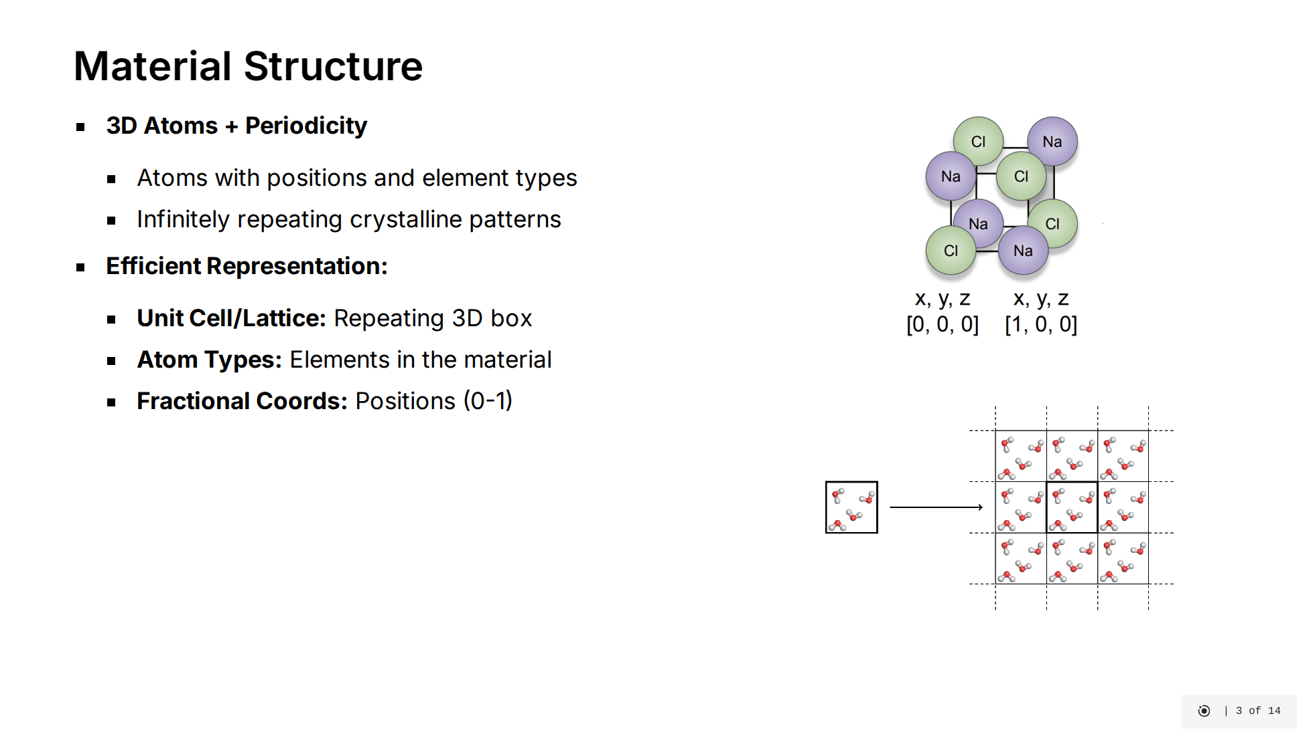
Notes:
Let's get concrete about what we're actually trying to generate. [click] At the most basic level, materials are collections of atoms positioned in 3D space with specific chemical identities. But what makes materials science challenging is that real materials aren't just a handful of atoms - they're infinitely repeating structures. Most solid materials form ordered, crystalline arrangements where the same pattern repeats throughout space. - Here you see atoms arranged within a single unit cell - this is our fundamental building block. - And this shows how that unit cell repeats infinitely to form the complete material structure. Our generative models need to learn how to create all three components while ensuring the resulting structure is physically stable. [click] To efficiently represent these infinite structures, we need three components: - The unit cell or lattice: a 3D "box" defined by vectors that repeats throughout space - The atom types: which chemical elements are present in our material - The fractional coordinates: where each atom sits within the unit cell, using a 0-1 scale relative to the cell dimensions

Slide 7
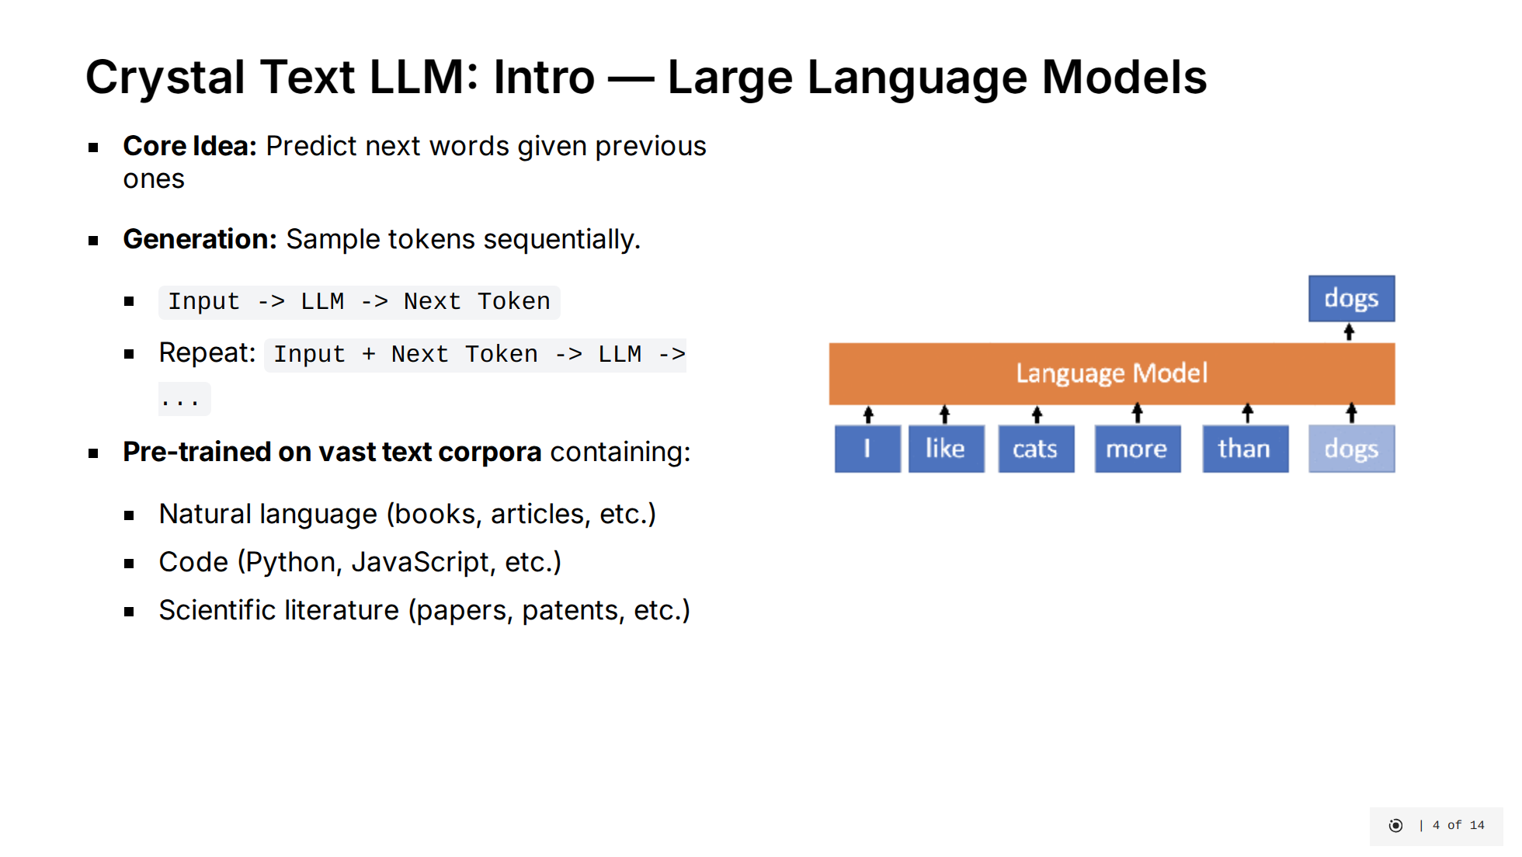
Notes:
Crystal Text LLM uses large language model techniques to predict the next token from the previous text, generating content one step at a time. It’s trained on massive data—books, code, and technical papers—giving it broad capabilities to understand and produce human-like text.

Slide 8
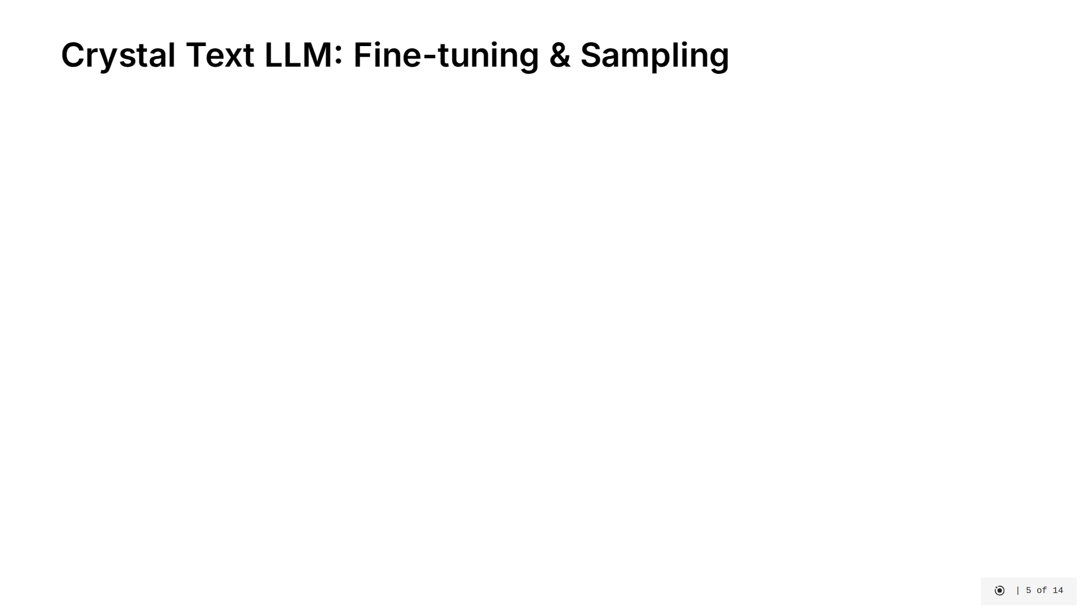
Notes:
So, how do we apply LLMs to generate crystals? The Crystal Text LLM paper proposes a straightforward approach. [click] Instead of designing complex architectures, they fine-tune a large, pre-trained LLM (LLaMA-2) on crystal data. The idea is to leverage the powerful pattern recognition abilities the LLM already possesses from its text pre-training. [click] They represent the crystal structure – lattice parameters, atom types, and fractional coordinates – as a simple, formatted string. This converts the 3D problem into a 1D sequence generation task that LLMs excel at. [click] Fine-tuning is done efficiently using techniques like LoRA (Low-Rank Adaptation), which only modifies a small fraction of the model's parameters. They use specific prompts to train the model for different tasks like unconditional generation, generating based on desired properties (conditional), or filling in missing atoms (infilling). Data augmentations, like randomly shifting coordinates, help the model learn physical symmetries. [click] Generating a new crystal is then just standard autoregressive sampling. The model generates the formatted string token by token, and this string is then parsed back into a 3D crystal structure. This method achieved surprisingly good results, generating stable materials at high rates.

Slide 9
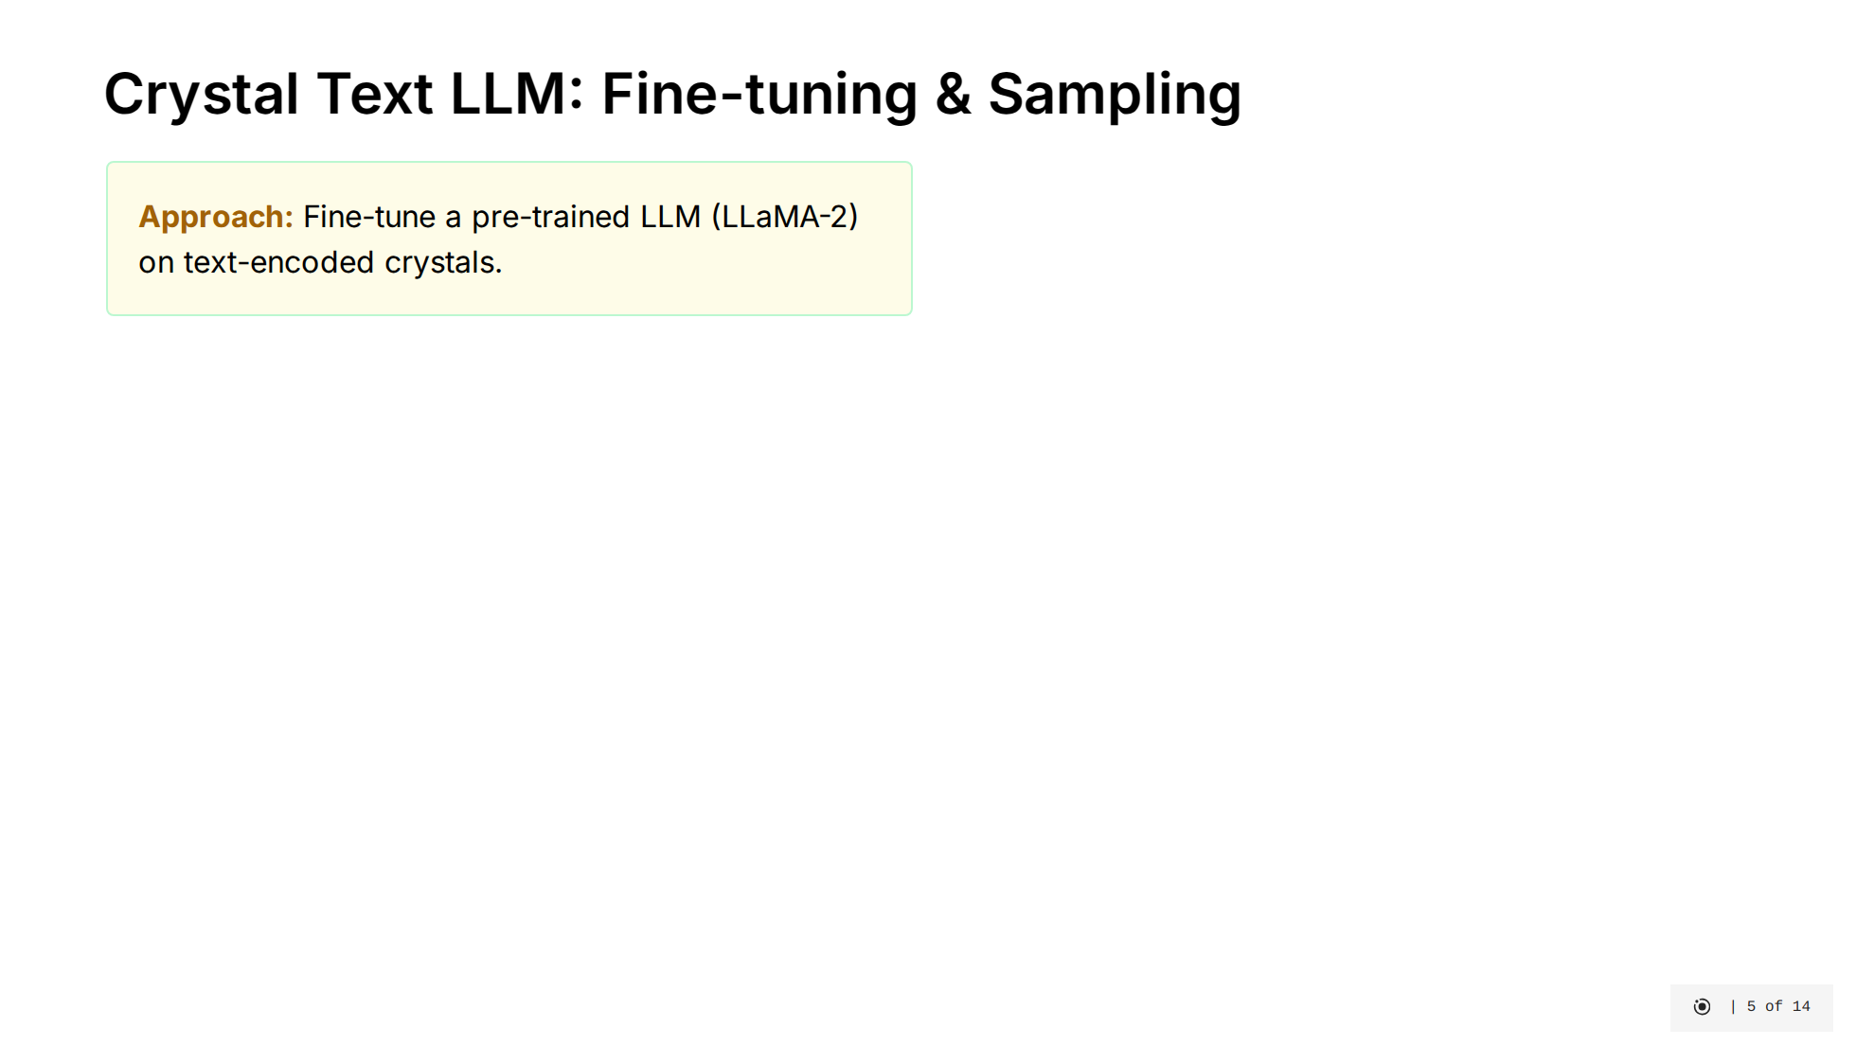
Notes:
So, how do we apply LLMs to generate crystals? The Crystal Text LLM paper proposes a straightforward approach. [click] Instead of designing complex architectures, they fine-tune a large, pre-trained LLM (LLaMA-2) on crystal data. The idea is to leverage the powerful pattern recognition abilities the LLM already possesses from its text pre-training. [click] They represent the crystal structure – lattice parameters, atom types, and fractional coordinates – as a simple, formatted string. This converts the 3D problem into a 1D sequence generation task that LLMs excel at. [click] Fine-tuning is done efficiently using techniques like LoRA (Low-Rank Adaptation), which only modifies a small fraction of the model's parameters. They use specific prompts to train the model for different tasks like unconditional generation, generating based on desired properties (conditional), or filling in missing atoms (infilling). Data augmentations, like randomly shifting coordinates, help the model learn physical symmetries. [click] Generating a new crystal is then just standard autoregressive sampling. The model generates the formatted string token by token, and this string is then parsed back into a 3D crystal structure. This method achieved surprisingly good results, generating stable materials at high rates.

Slide 10
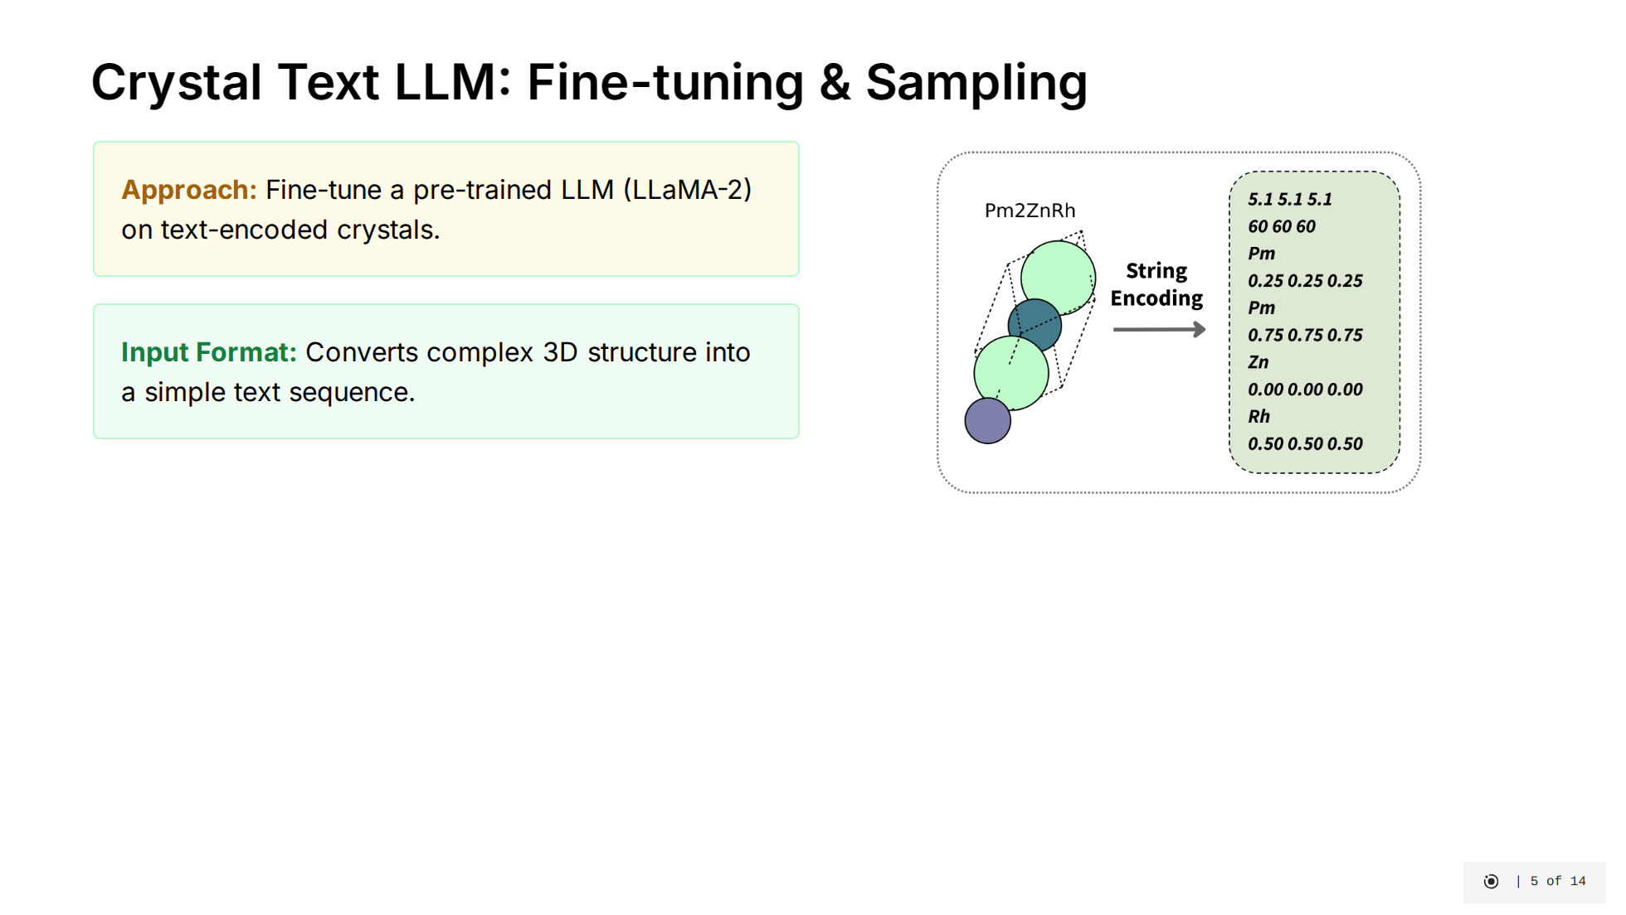
Notes:
So, how do we apply LLMs to generate crystals? The Crystal Text LLM paper proposes a straightforward approach. [click] Instead of designing complex architectures, they fine-tune a large, pre-trained LLM (LLaMA-2) on crystal data. The idea is to leverage the powerful pattern recognition abilities the LLM already possesses from its text pre-training. [click] They represent the crystal structure – lattice parameters, atom types, and fractional coordinates – as a simple, formatted string. This converts the 3D problem into a 1D sequence generation task that LLMs excel at. [click] Fine-tuning is done efficiently using techniques like LoRA (Low-Rank Adaptation), which only modifies a small fraction of the model's parameters. They use specific prompts to train the model for different tasks like unconditional generation, generating based on desired properties (conditional), or filling in missing atoms (infilling). Data augmentations, like randomly shifting coordinates, help the model learn physical symmetries. [click] Generating a new crystal is then just standard autoregressive sampling. The model generates the formatted string token by token, and this string is then parsed back into a 3D crystal structure. This method achieved surprisingly good results, generating stable materials at high rates.

Slide 11
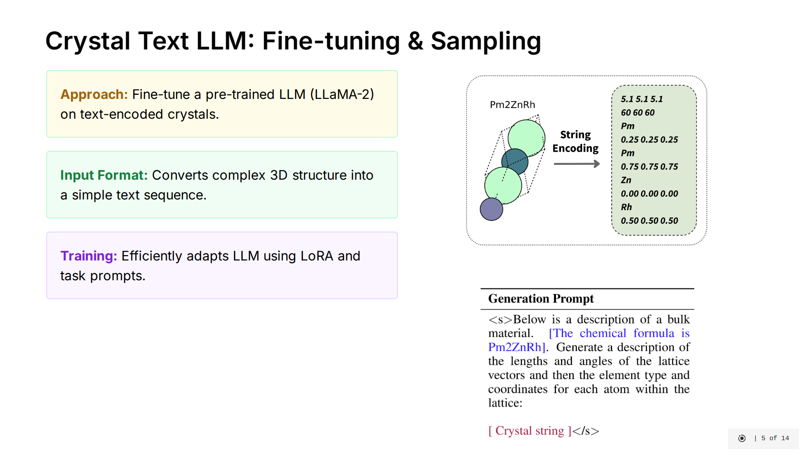
Notes:
So, how do we apply LLMs to generate crystals? The Crystal Text LLM paper proposes a straightforward approach. [click] Instead of designing complex architectures, they fine-tune a large, pre-trained LLM (LLaMA-2) on crystal data. The idea is to leverage the powerful pattern recognition abilities the LLM already possesses from its text pre-training. [click] They represent the crystal structure – lattice parameters, atom types, and fractional coordinates – as a simple, formatted string. This converts the 3D problem into a 1D sequence generation task that LLMs excel at. [click] Fine-tuning is done efficiently using techniques like LoRA (Low-Rank Adaptation), which only modifies a small fraction of the model's parameters. They use specific prompts to train the model for different tasks like unconditional generation, generating based on desired properties (conditional), or filling in missing atoms (infilling). Data augmentations, like randomly shifting coordinates, help the model learn physical symmetries. [click] Generating a new crystal is then just standard autoregressive sampling. The model generates the formatted string token by token, and this string is then parsed back into a 3D crystal structure. This method achieved surprisingly good results, generating stable materials at high rates.

Slide 12
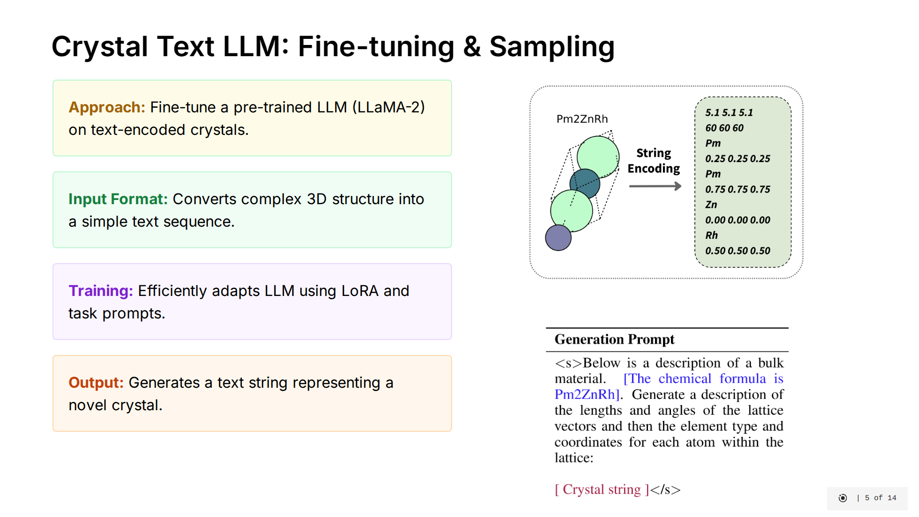
Notes:
So, how do we apply LLMs to generate crystals? The Crystal Text LLM paper proposes a straightforward approach. [click] Instead of designing complex architectures, they fine-tune a large, pre-trained LLM (LLaMA-2) on crystal data. The idea is to leverage the powerful pattern recognition abilities the LLM already possesses from its text pre-training. [click] They represent the crystal structure – lattice parameters, atom types, and fractional coordinates – as a simple, formatted string. This converts the 3D problem into a 1D sequence generation task that LLMs excel at. [click] Fine-tuning is done efficiently using techniques like LoRA (Low-Rank Adaptation), which only modifies a small fraction of the model's parameters. They use specific prompts to train the model for different tasks like unconditional generation, generating based on desired properties (conditional), or filling in missing atoms (infilling). Data augmentations, like randomly shifting coordinates, help the model learn physical symmetries. [click] Generating a new crystal is then just standard autoregressive sampling. The model generates the formatted string token by token, and this string is then parsed back into a 3D crystal structure. This method achieved surprisingly good results, generating stable materials at high rates.

Slide 13
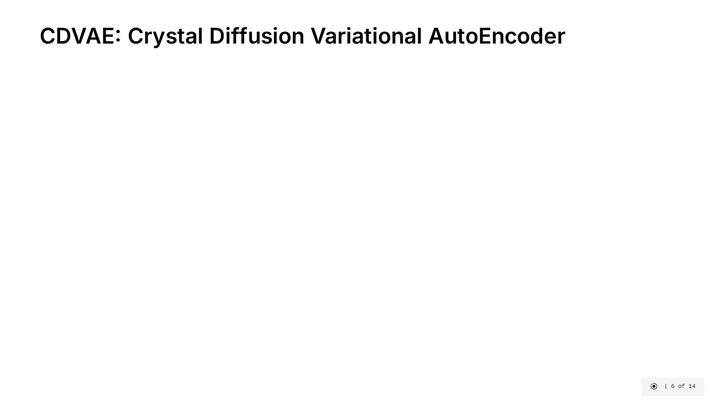

Slide 14
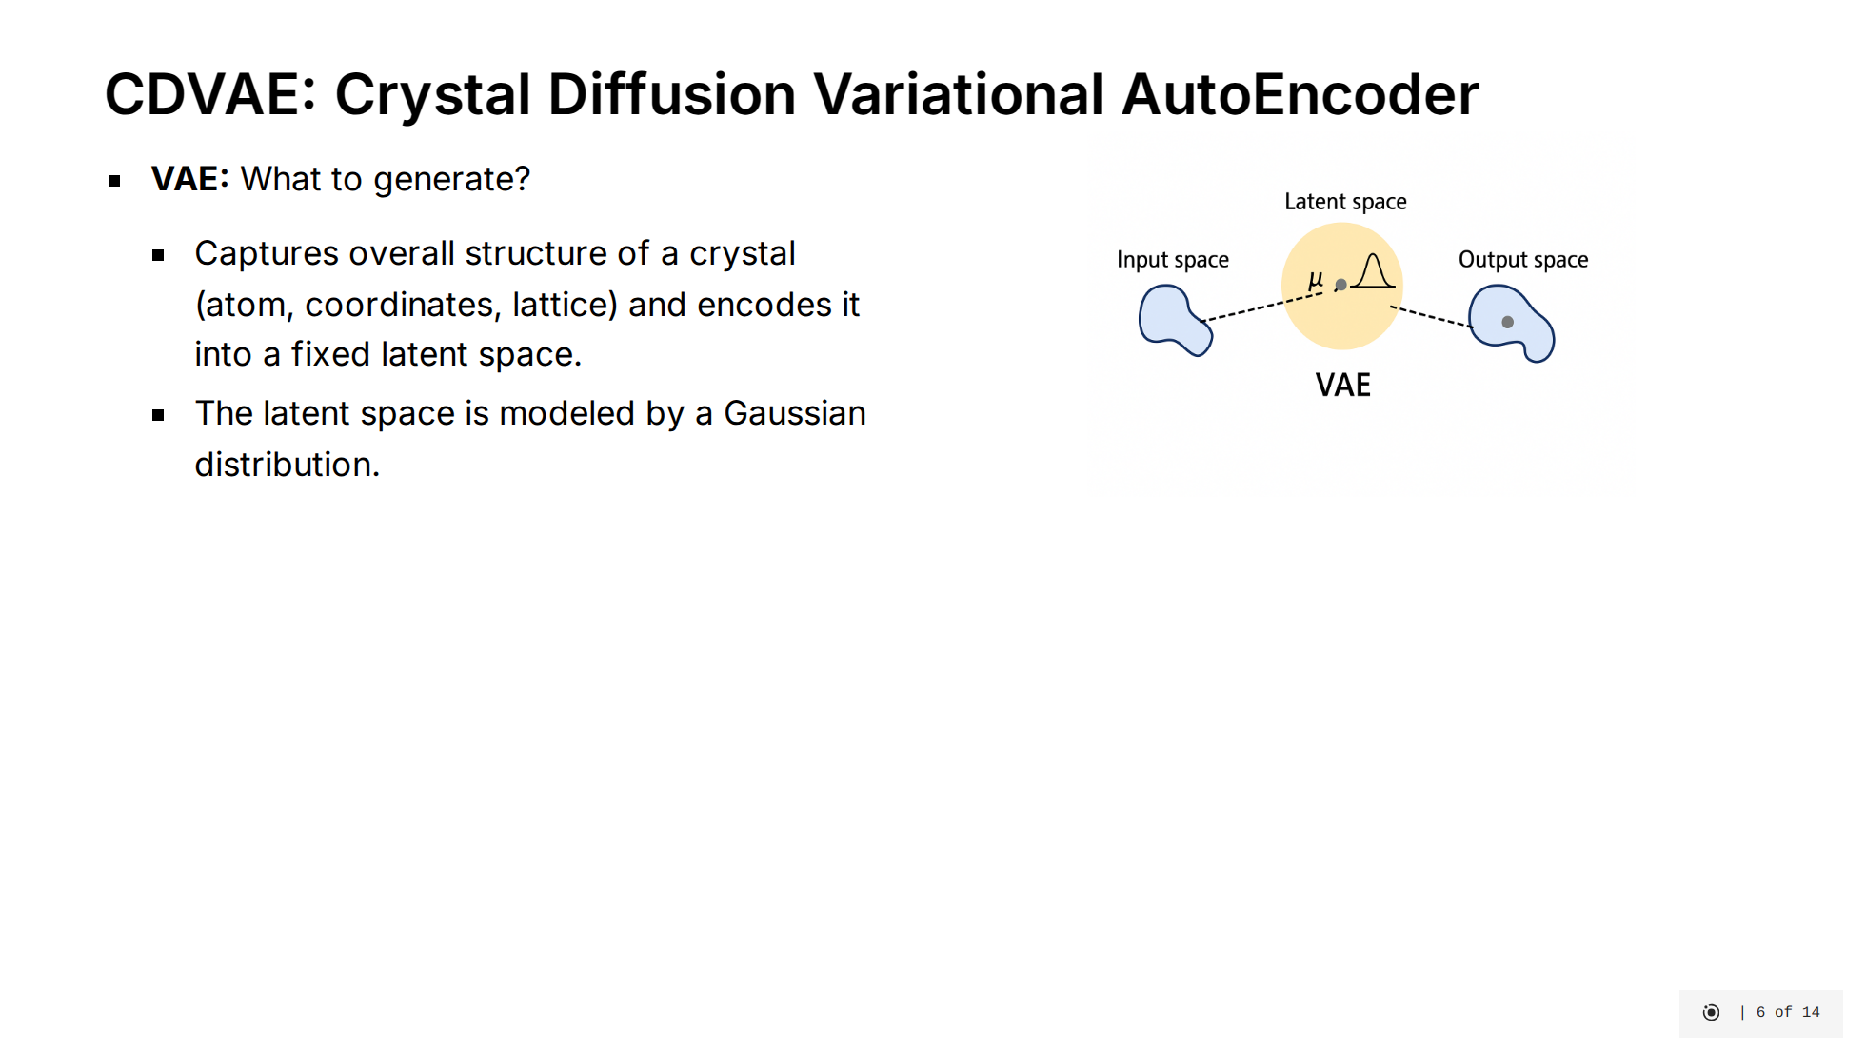

Slide 15
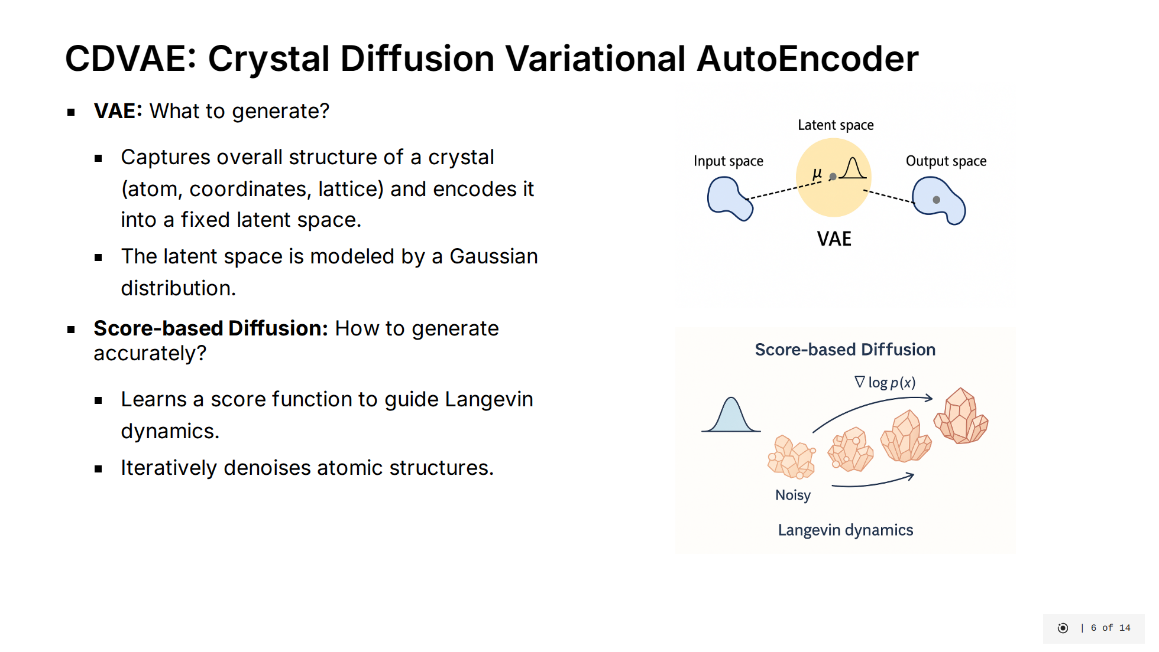

Slide 16
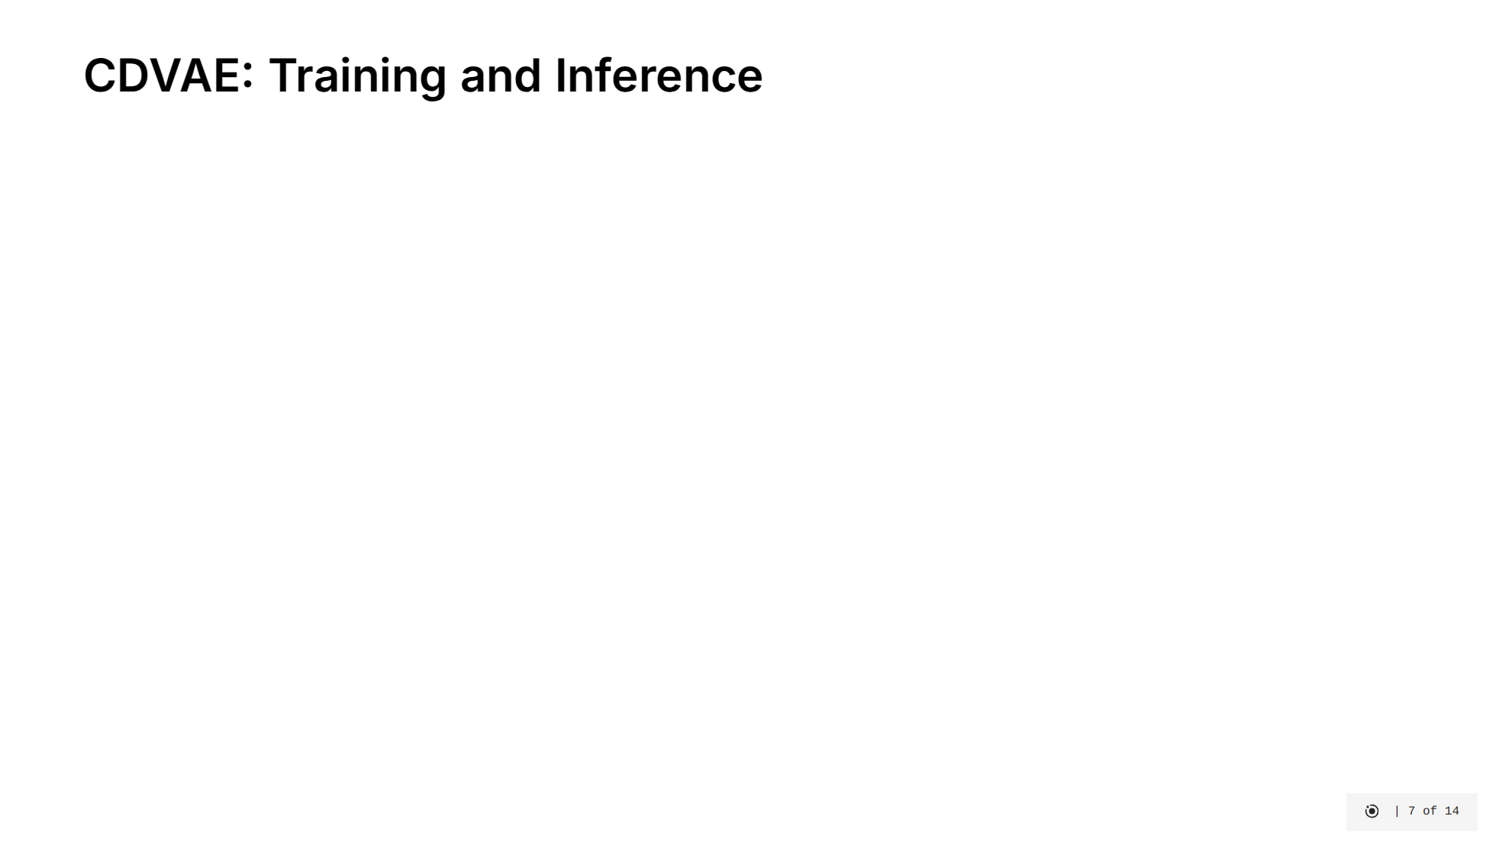

Slide 17
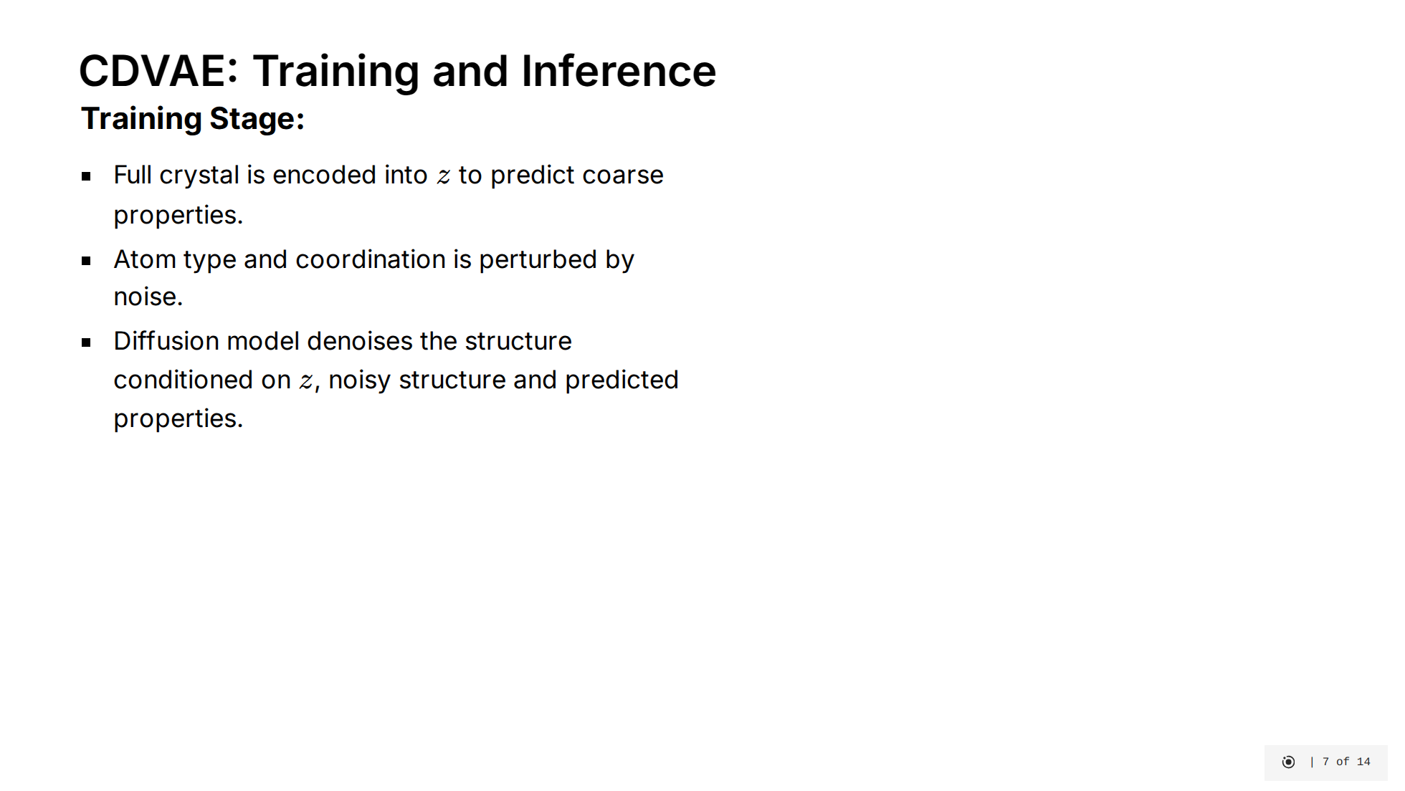

Slide 18
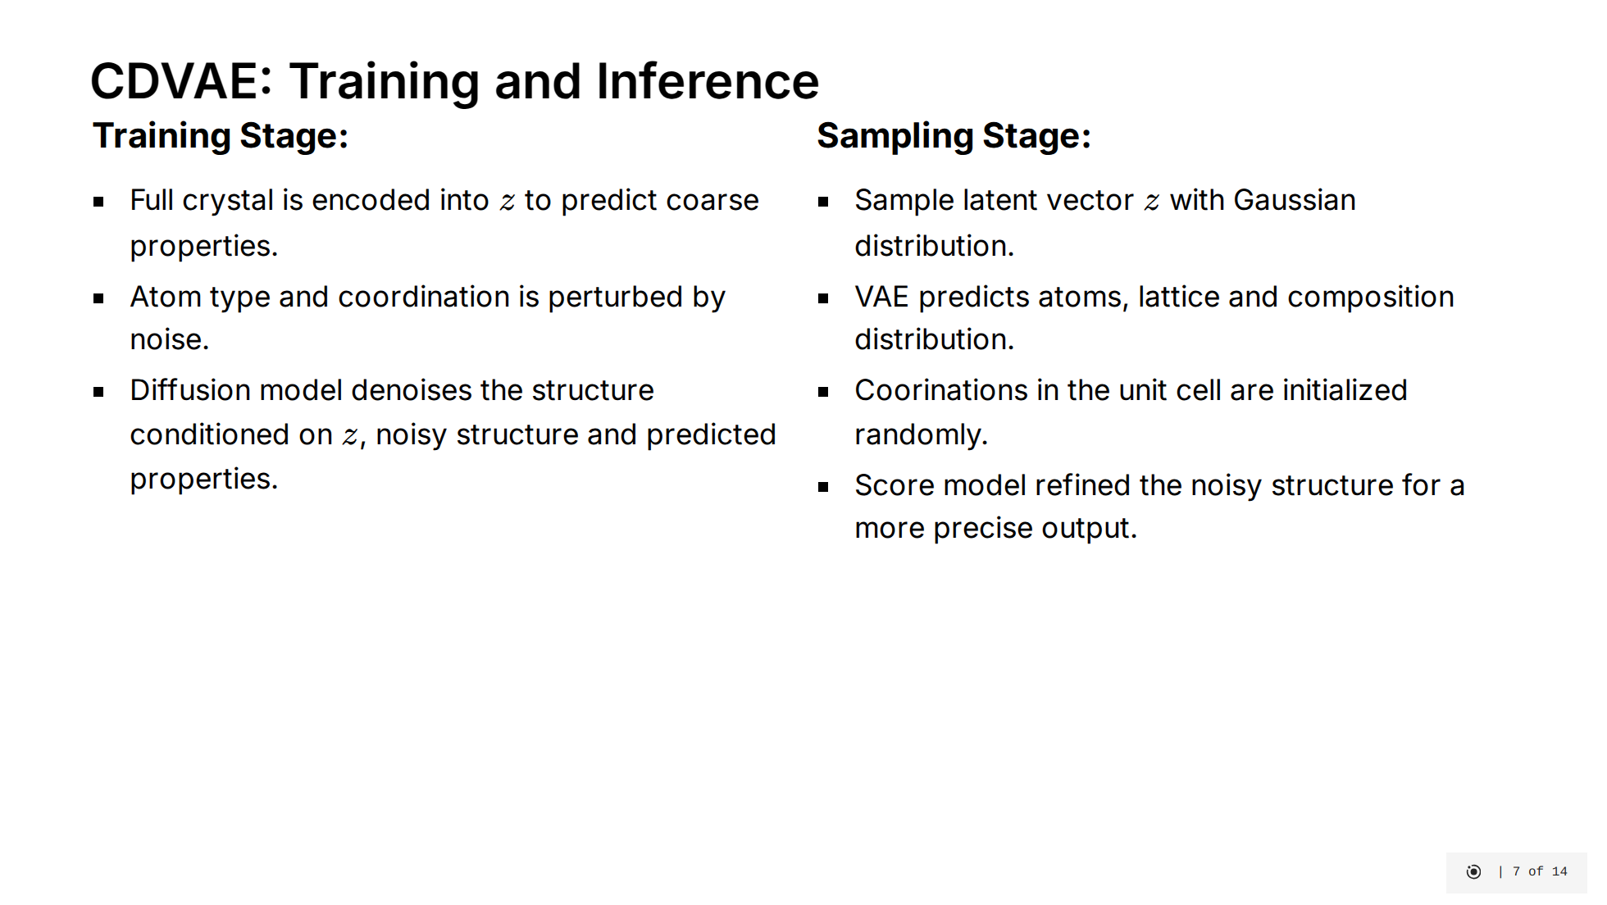

Slide 19
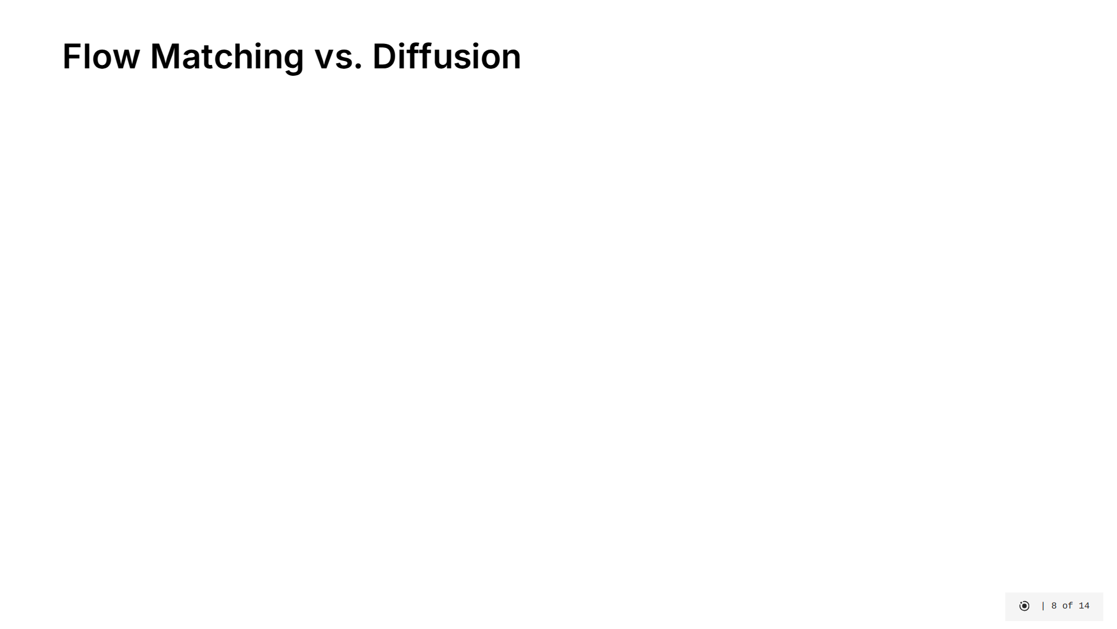
Notes:
Let me explain how Flow Matching differs from diffusion models and why it's better for our materials task. [click] Diffusion models use a stochastic process - they gradually add random noise to data, then learn to reverse this noise step by step. They're based on Stochastic Differential Equations which incorporate both deterministic and random components. This randomness makes them less efficient and harder to control. [click] Flow Matching instead learns deterministic paths directly from noise to data. It focuses on learning a vector field that optimally transports points between distributions using Ordinary Differential Equations. The paths are smooth and direct, following principles of optimal transport. [click] This approach offers several key advantages: - Sampling requires significantly fewer steps (50-250 vs 1000+ for diffusion) - It allows more flexible choice of base distributions, which is crucial for modeling physical structures - The deterministic nature makes it better suited for handling the complex symmetries and constraints of crystal structures The visualizations show how diffusion takes a meandering path through noise, while flow matching follows direct trajectories. This efficiency translates directly to faster material generation with better physical properties.

Slide 20
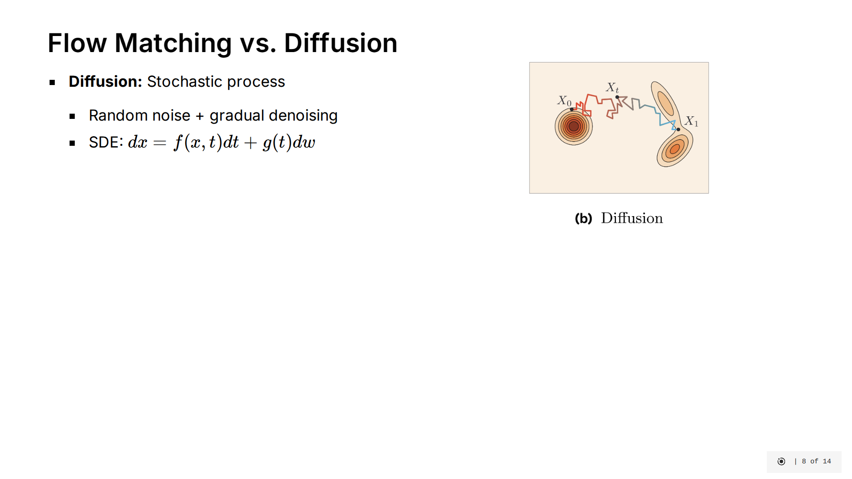
Notes:
Let me explain how Flow Matching differs from diffusion models and why it's better for our materials task. [click] Diffusion models use a stochastic process - they gradually add random noise to data, then learn to reverse this noise step by step. They're based on Stochastic Differential Equations which incorporate both deterministic and random components. This randomness makes them less efficient and harder to control. [click] Flow Matching instead learns deterministic paths directly from noise to data. It focuses on learning a vector field that optimally transports points between distributions using Ordinary Differential Equations. The paths are smooth and direct, following principles of optimal transport. [click] This approach offers several key advantages: - Sampling requires significantly fewer steps (50-250 vs 1000+ for diffusion) - It allows more flexible choice of base distributions, which is crucial for modeling physical structures - The deterministic nature makes it better suited for handling the complex symmetries and constraints of crystal structures The visualizations show how diffusion takes a meandering path through noise, while flow matching follows direct trajectories. This efficiency translates directly to faster material generation with better physical properties.

Slide 21
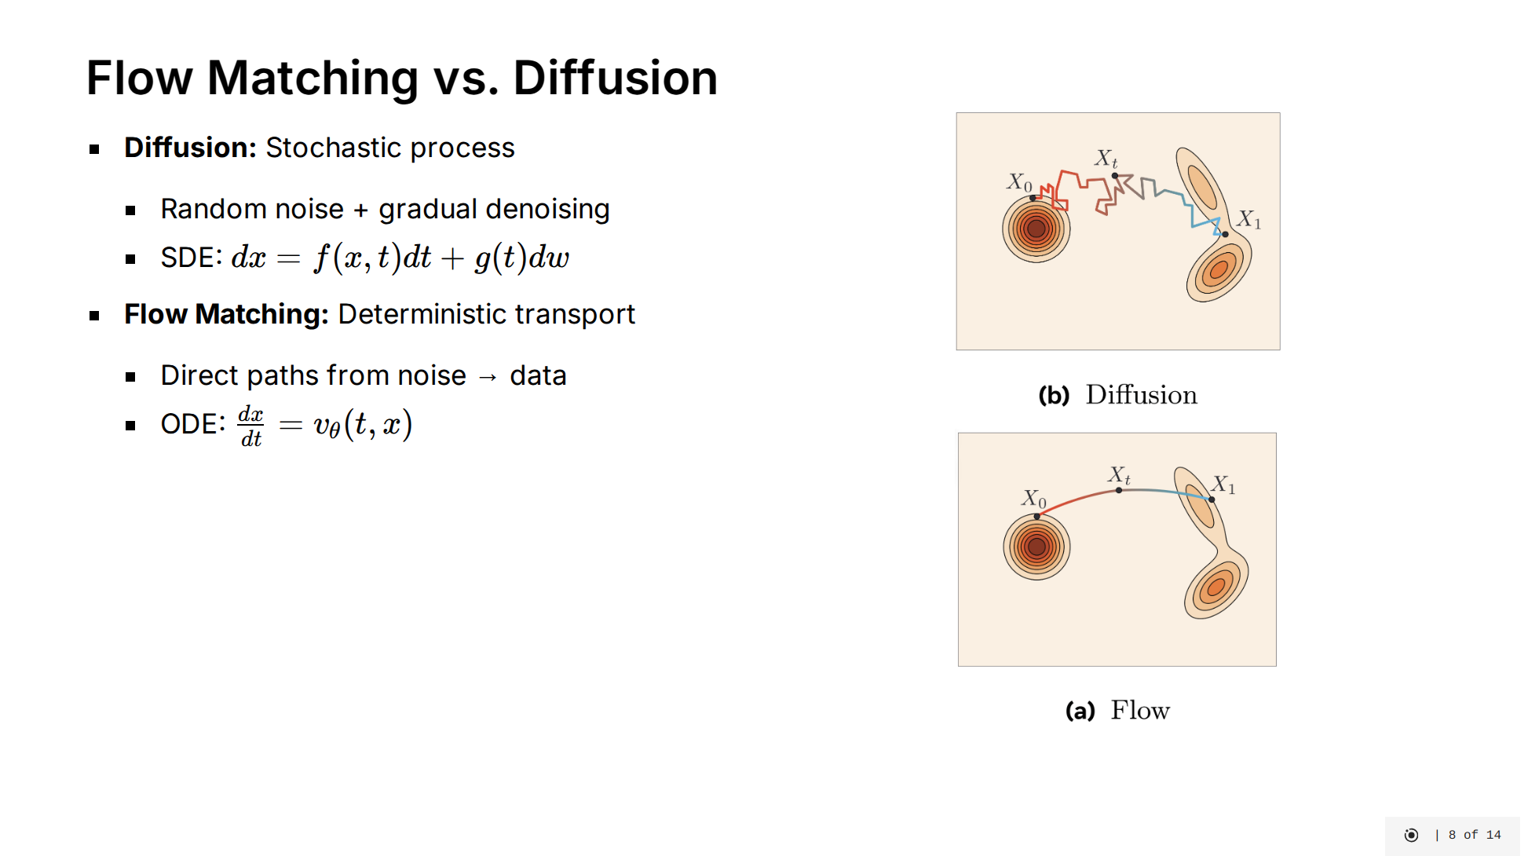
Notes:
Let me explain how Flow Matching differs from diffusion models and why it's better for our materials task. [click] Diffusion models use a stochastic process - they gradually add random noise to data, then learn to reverse this noise step by step. They're based on Stochastic Differential Equations which incorporate both deterministic and random components. This randomness makes them less efficient and harder to control. [click] Flow Matching instead learns deterministic paths directly from noise to data. It focuses on learning a vector field that optimally transports points between distributions using Ordinary Differential Equations. The paths are smooth and direct, following principles of optimal transport. [click] This approach offers several key advantages: - Sampling requires significantly fewer steps (50-250 vs 1000+ for diffusion) - It allows more flexible choice of base distributions, which is crucial for modeling physical structures - The deterministic nature makes it better suited for handling the complex symmetries and constraints of crystal structures The visualizations show how diffusion takes a meandering path through noise, while flow matching follows direct trajectories. This efficiency translates directly to faster material generation with better physical properties.

Slide 22
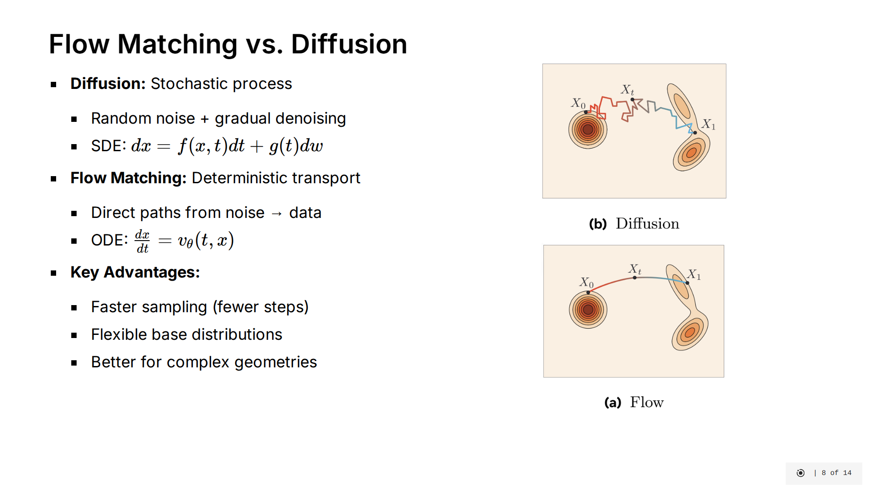
Notes:
Let me explain how Flow Matching differs from diffusion models and why it's better for our materials task. [click] Diffusion models use a stochastic process - they gradually add random noise to data, then learn to reverse this noise step by step. They're based on Stochastic Differential Equations which incorporate both deterministic and random components. This randomness makes them less efficient and harder to control. [click] Flow Matching instead learns deterministic paths directly from noise to data. It focuses on learning a vector field that optimally transports points between distributions using Ordinary Differential Equations. The paths are smooth and direct, following principles of optimal transport. [click] This approach offers several key advantages: - Sampling requires significantly fewer steps (50-250 vs 1000+ for diffusion) - It allows more flexible choice of base distributions, which is crucial for modeling physical structures - The deterministic nature makes it better suited for handling the complex symmetries and constraints of crystal structures The visualizations show how diffusion takes a meandering path through noise, while flow matching follows direct trajectories. This efficiency translates directly to faster material generation with better physical properties.

Slide 23
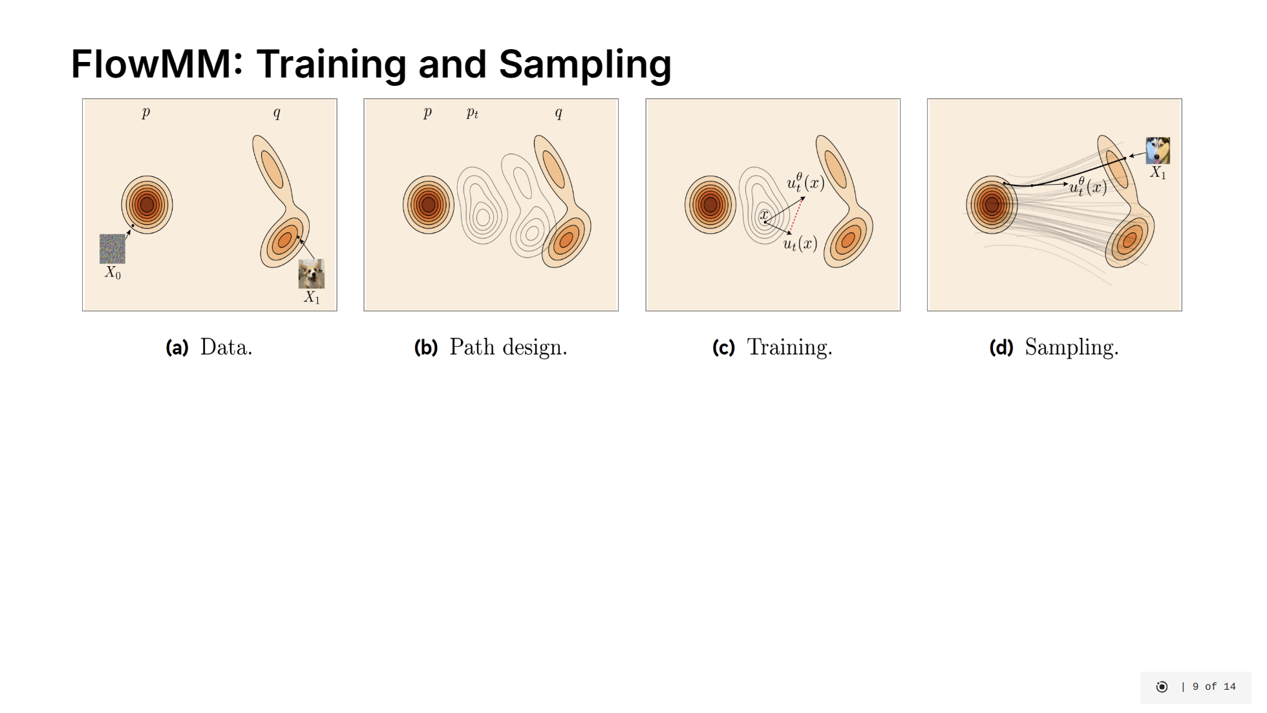
Notes:
Now let's look at how FlowMM specifically works for generating materials. The image visualizes how the vector field transforms random noise into realistic material structures. [click] For training, FlowMM learns a vector field that transforms simple distributions into complex material structures: - It uses physics-informed base distributions: uniform on torus for atom positions, binary encoding for atom types, and informed priors for lattice parameters - The model learns a vector field following optimal transport principles between these simple distributions and real materials - Throughout this process, it maintains critical crystal symmetries: translation, rotation, and permutation invariance [click] For sampling, the process is elegantly simple - we solve an Ordinary Differential Equation: - First draw samples from the base distributions - Then numerically integrate the ODE from t=0 to t=1 - This needs only 50-250 integration steps compared to 1000+ for diffusion models - The result is a physically realistic material with proper atomic positions, types, and unit cell parameters The deterministic nature of flow matching allows for this significant efficiency gain while producing high-quality structures that respect physical constraints.

Slide 24
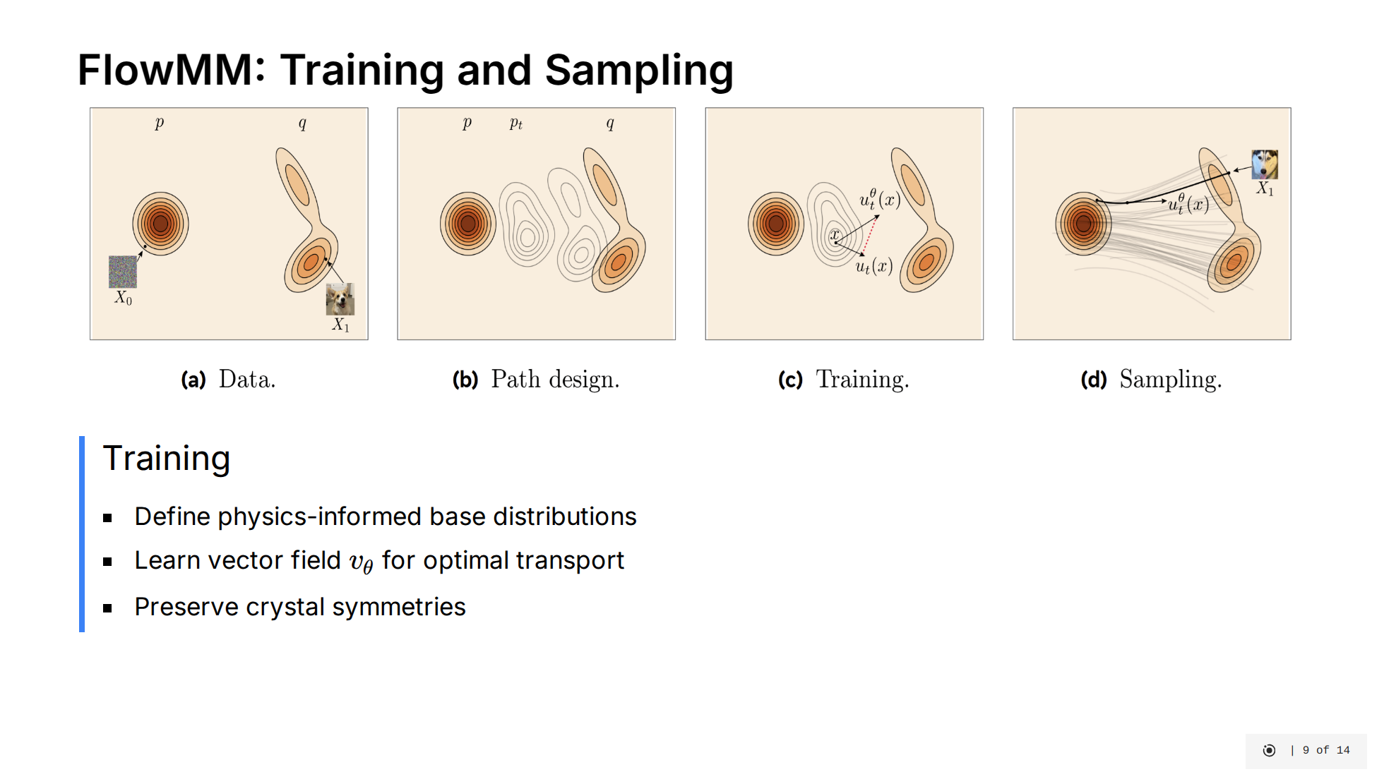
Notes:
Now let's look at how FlowMM specifically works for generating materials. The image visualizes how the vector field transforms random noise into realistic material structures. [click] For training, FlowMM learns a vector field that transforms simple distributions into complex material structures: - It uses physics-informed base distributions: uniform on torus for atom positions, binary encoding for atom types, and informed priors for lattice parameters - The model learns a vector field following optimal transport principles between these simple distributions and real materials - Throughout this process, it maintains critical crystal symmetries: translation, rotation, and permutation invariance [click] For sampling, the process is elegantly simple - we solve an Ordinary Differential Equation: - First draw samples from the base distributions - Then numerically integrate the ODE from t=0 to t=1 - This needs only 50-250 integration steps compared to 1000+ for diffusion models - The result is a physically realistic material with proper atomic positions, types, and unit cell parameters The deterministic nature of flow matching allows for this significant efficiency gain while producing high-quality structures that respect physical constraints.

Slide 25
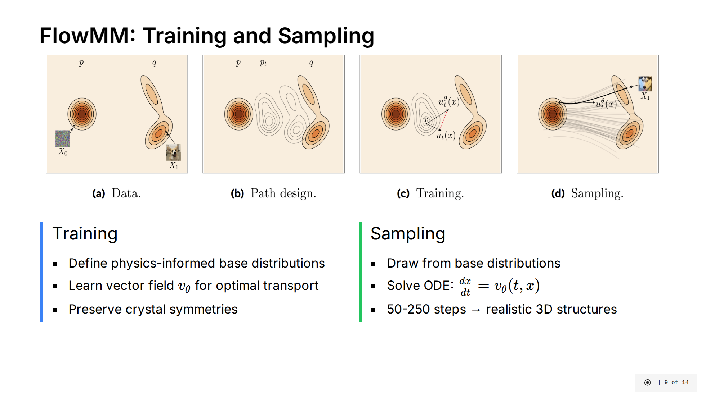
Notes:
Now let's look at how FlowMM specifically works for generating materials. The image visualizes how the vector field transforms random noise into realistic material structures. [click] For training, FlowMM learns a vector field that transforms simple distributions into complex material structures: - It uses physics-informed base distributions: uniform on torus for atom positions, binary encoding for atom types, and informed priors for lattice parameters - The model learns a vector field following optimal transport principles between these simple distributions and real materials - Throughout this process, it maintains critical crystal symmetries: translation, rotation, and permutation invariance [click] For sampling, the process is elegantly simple - we solve an Ordinary Differential Equation: - First draw samples from the base distributions - Then numerically integrate the ODE from t=0 to t=1 - This needs only 50-250 integration steps compared to 1000+ for diffusion models - The result is a physically realistic material with proper atomic positions, types, and unit cell parameters The deterministic nature of flow matching allows for this significant efficiency gain while producing high-quality structures that respect physical constraints.

Slide 26

Notes:
Let's start by understanding our dataset and the challenges in evaluating generative models for materials. [click] Our study uses the MP-20 dataset - a comprehensive collection of 45,231 materials drawn from the Materials Project database. This dataset includes: - 89 different chemical elements - Materials with 1 to 20 atoms per unit cell - Experimentally verified inorganic materials What makes MP-20 particularly valuable is that it contains mostly globally stable materials that can actually be synthesized in a laboratory. This means a model that performs well on MP-20 has real potential for practical materials discovery. [click] However, evaluating generative models for materials presents unique challenges: First, while Density Functional Theory (DFT) calculations would be the gold standard for verifying if generated materials are truly stable, these quantum mechanical simulations are computationally prohibitive to run at scale. Second, materials have multiple physical invariances - they remain identical under rotation, translation, permutation of atoms, and different choices of unit cell. This makes direct comparison difficult. Third, because of these constraints, we must rely on proxy metrics that approximate physical validity and quality without running full quantum simulations. Finally, there's an inherent trade-off between generating diverse structures and ensuring they're all physically realistic. Our metrics need to balance these considerations carefully.

Slide 27
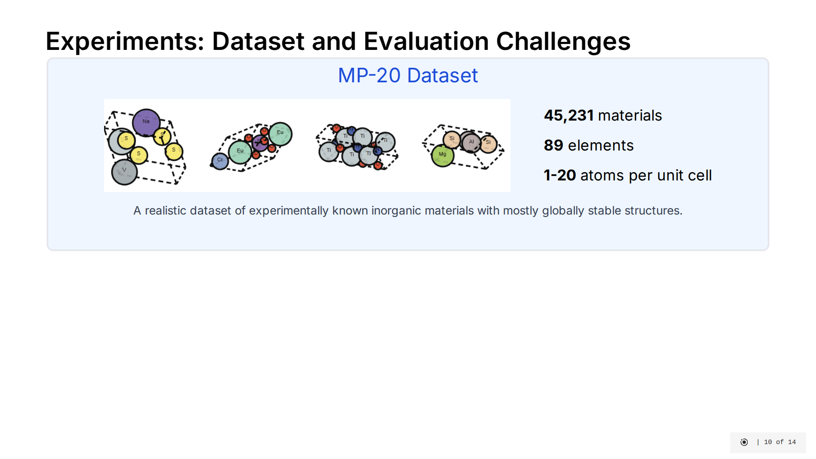
Notes:
Let's start by understanding our dataset and the challenges in evaluating generative models for materials. [click] Our study uses the MP-20 dataset - a comprehensive collection of 45,231 materials drawn from the Materials Project database. This dataset includes: - 89 different chemical elements - Materials with 1 to 20 atoms per unit cell - Experimentally verified inorganic materials What makes MP-20 particularly valuable is that it contains mostly globally stable materials that can actually be synthesized in a laboratory. This means a model that performs well on MP-20 has real potential for practical materials discovery. [click] However, evaluating generative models for materials presents unique challenges: First, while Density Functional Theory (DFT) calculations would be the gold standard for verifying if generated materials are truly stable, these quantum mechanical simulations are computationally prohibitive to run at scale. Second, materials have multiple physical invariances - they remain identical under rotation, translation, permutation of atoms, and different choices of unit cell. This makes direct comparison difficult. Third, because of these constraints, we must rely on proxy metrics that approximate physical validity and quality without running full quantum simulations. Finally, there's an inherent trade-off between generating diverse structures and ensuring they're all physically realistic. Our metrics need to balance these considerations carefully.

Slide 28
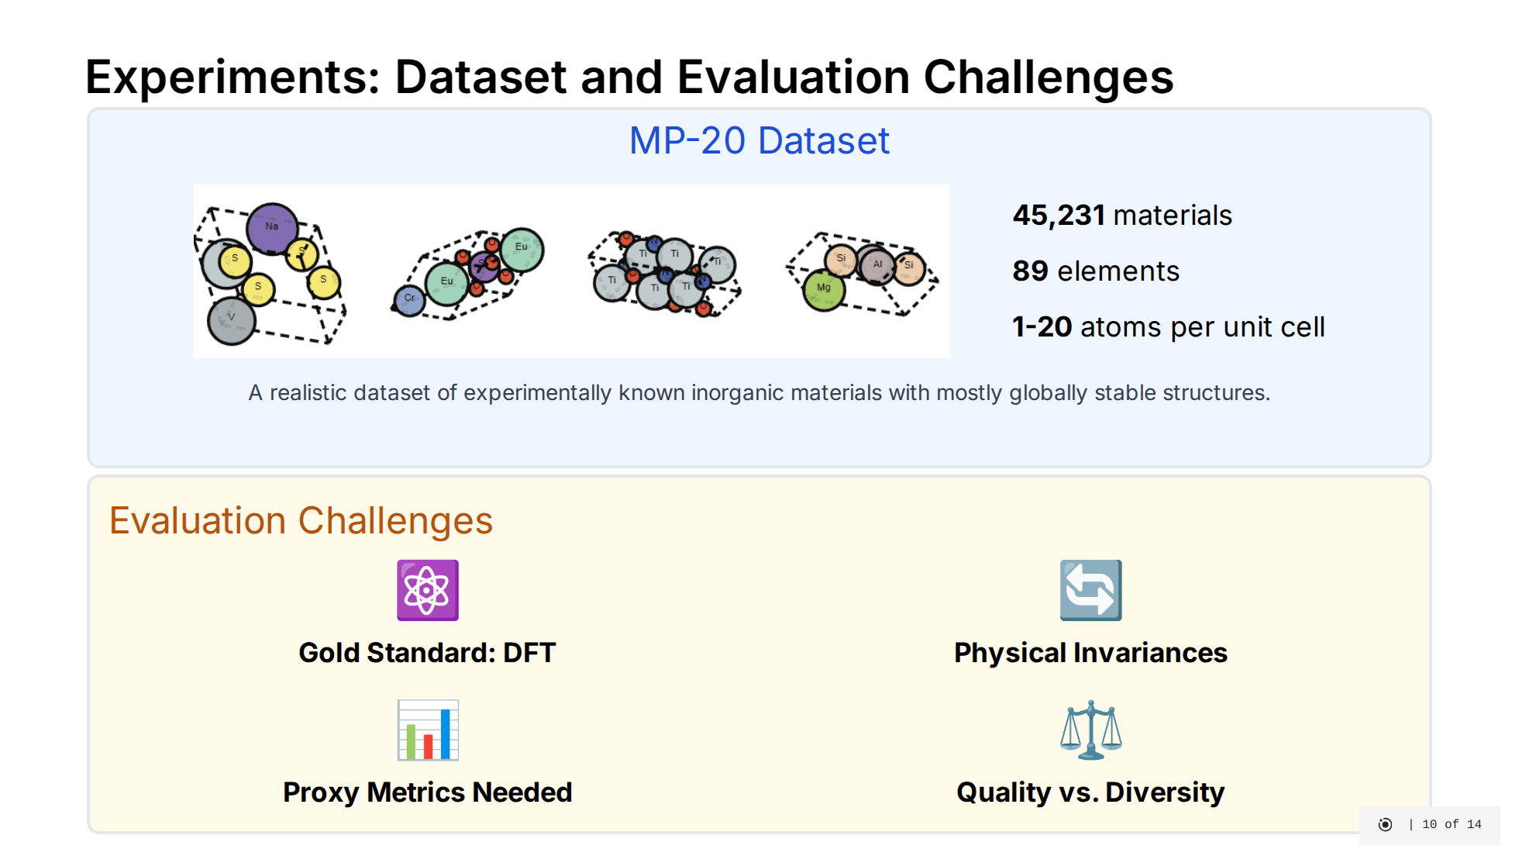
Notes:
Let's start by understanding our dataset and the challenges in evaluating generative models for materials. [click] Our study uses the MP-20 dataset - a comprehensive collection of 45,231 materials drawn from the Materials Project database. This dataset includes: - 89 different chemical elements - Materials with 1 to 20 atoms per unit cell - Experimentally verified inorganic materials What makes MP-20 particularly valuable is that it contains mostly globally stable materials that can actually be synthesized in a laboratory. This means a model that performs well on MP-20 has real potential for practical materials discovery. [click] However, evaluating generative models for materials presents unique challenges: First, while Density Functional Theory (DFT) calculations would be the gold standard for verifying if generated materials are truly stable, these quantum mechanical simulations are computationally prohibitive to run at scale. Second, materials have multiple physical invariances - they remain identical under rotation, translation, permutation of atoms, and different choices of unit cell. This makes direct comparison difficult. Third, because of these constraints, we must rely on proxy metrics that approximate physical validity and quality without running full quantum simulations. Finally, there's an inherent trade-off between generating diverse structures and ensuring they're all physically realistic. Our metrics need to balance these considerations carefully.

Slide 29
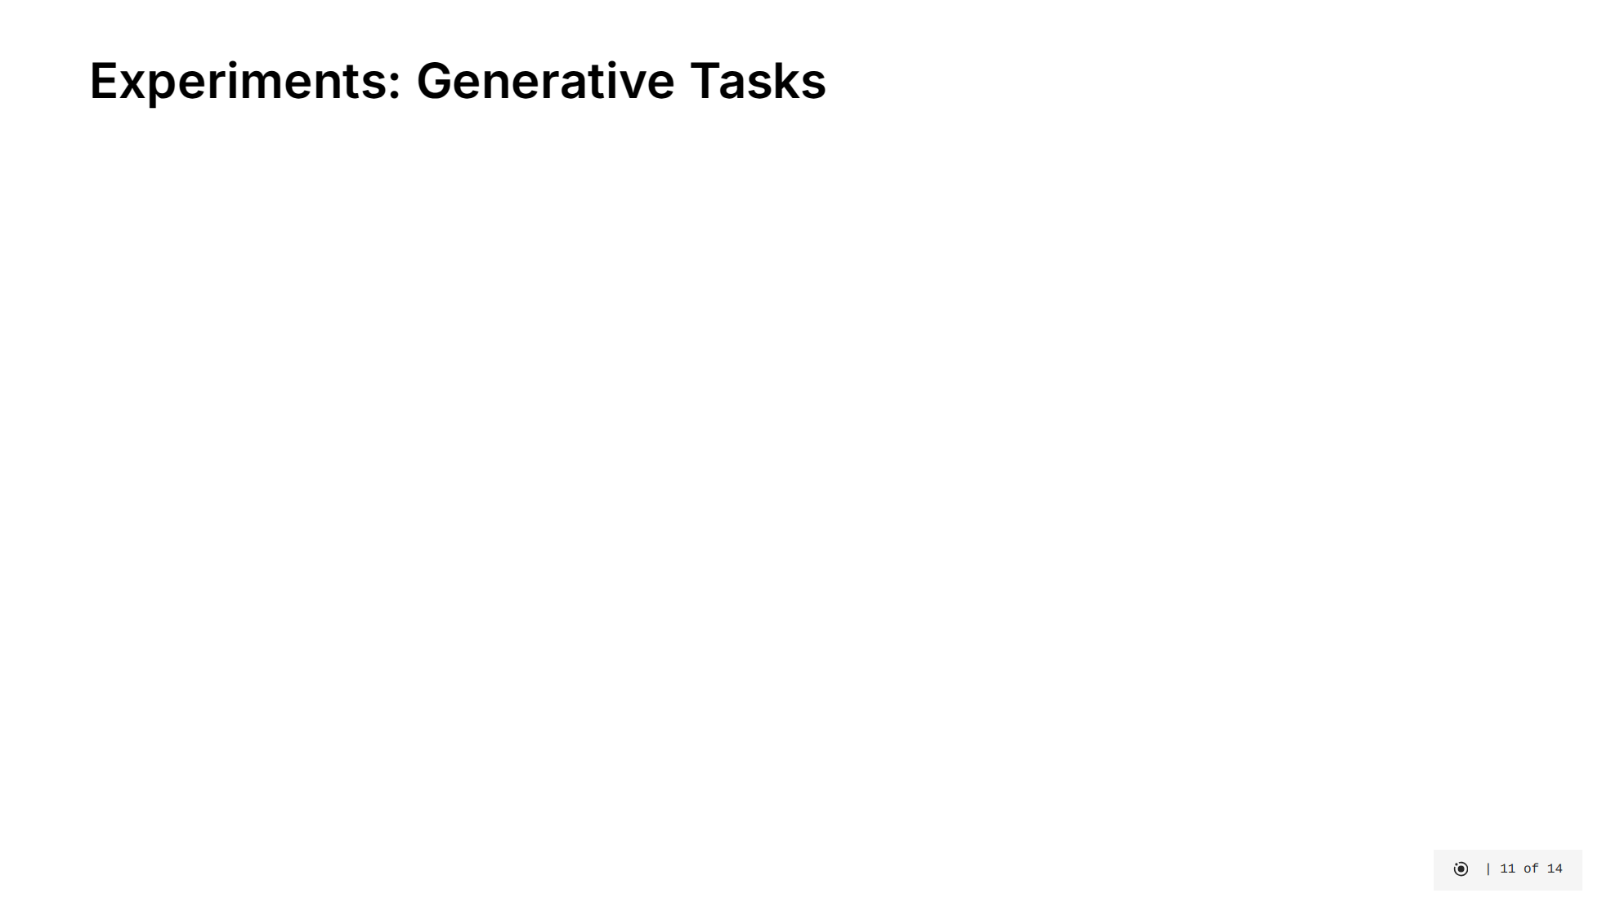
Notes:
Let's understand the two fundamental generative tasks we're exploring in this project. [click] First is De Novo Generation, or DNG. This is the more ambitious task where we aim to generate completely new materials from scratch. The model must learn to create both the chemical composition (what elements to use) and the 3D structure (how to arrange those atoms). To evaluate DNG models, we look at: - Validity: Are the generated structures physically plausible? - Coverage: Do they represent diverse and realistic materials? - Property distributions: Do their physical properties match those of real materials? [click] The second task is Crystal Structure Prediction, or CSP. Here, we already know the chemical composition (like SiO₂ for quartz), but we need to predict the stable 3D arrangement of those atoms. CSP is evaluated using: - RMSE: How close are the predicted atom positions to the ground truth? - Match Rate: What percentage of predictions match known structures within a reasonable tolerance? [click] In our comparative study, we evaluate different generative approaches on both of these tasks to understand their strengths and limitations.

Slide 30
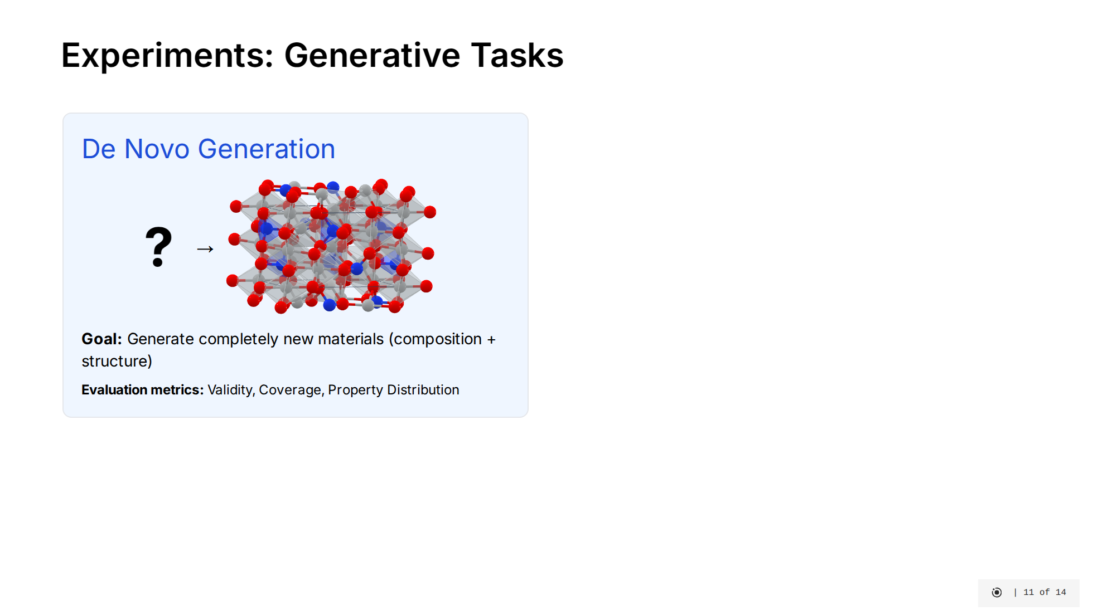
Notes:
Let's understand the two fundamental generative tasks we're exploring in this project. [click] First is De Novo Generation, or DNG. This is the more ambitious task where we aim to generate completely new materials from scratch. The model must learn to create both the chemical composition (what elements to use) and the 3D structure (how to arrange those atoms). To evaluate DNG models, we look at: - Validity: Are the generated structures physically plausible? - Coverage: Do they represent diverse and realistic materials? - Property distributions: Do their physical properties match those of real materials? [click] The second task is Crystal Structure Prediction, or CSP. Here, we already know the chemical composition (like SiO₂ for quartz), but we need to predict the stable 3D arrangement of those atoms. CSP is evaluated using: - RMSE: How close are the predicted atom positions to the ground truth? - Match Rate: What percentage of predictions match known structures within a reasonable tolerance? [click] In our comparative study, we evaluate different generative approaches on both of these tasks to understand their strengths and limitations.

Slide 31
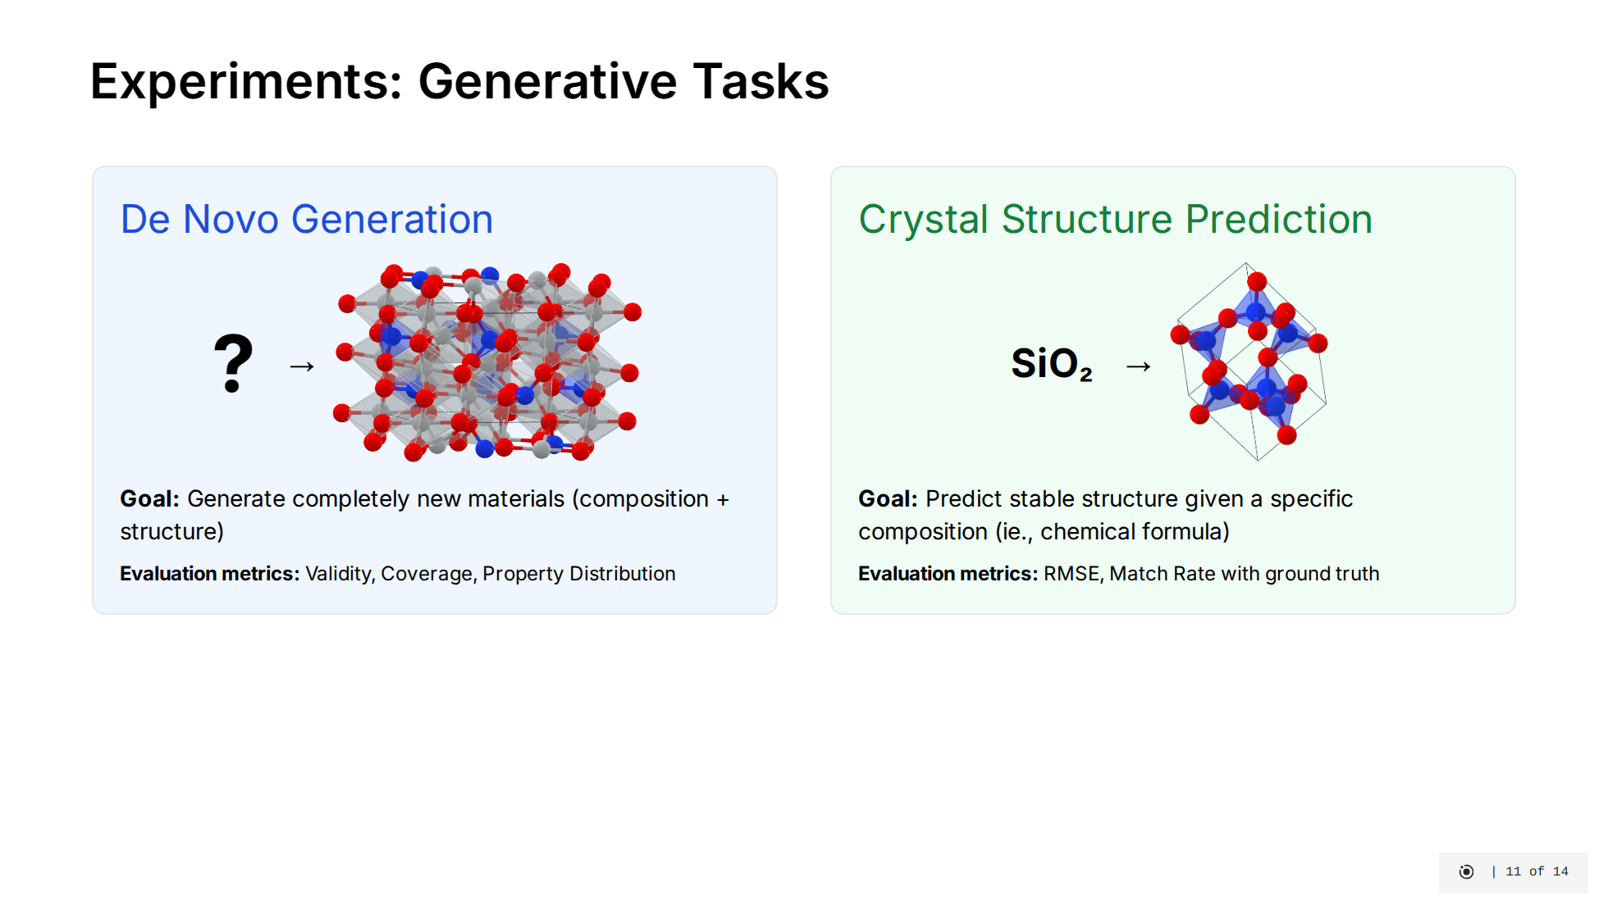
Notes:
Let's understand the two fundamental generative tasks we're exploring in this project. [click] First is De Novo Generation, or DNG. This is the more ambitious task where we aim to generate completely new materials from scratch. The model must learn to create both the chemical composition (what elements to use) and the 3D structure (how to arrange those atoms). To evaluate DNG models, we look at: - Validity: Are the generated structures physically plausible? - Coverage: Do they represent diverse and realistic materials? - Property distributions: Do their physical properties match those of real materials? [click] The second task is Crystal Structure Prediction, or CSP. Here, we already know the chemical composition (like SiO₂ for quartz), but we need to predict the stable 3D arrangement of those atoms. CSP is evaluated using: - RMSE: How close are the predicted atom positions to the ground truth? - Match Rate: What percentage of predictions match known structures within a reasonable tolerance? [click] In our comparative study, we evaluate different generative approaches on both of these tasks to understand their strengths and limitations.

Slide 32

Notes:
Let's examine the performance of our three models on both generative tasks. [click] For De Novo Generation: - LLaMA-2 shows strong compositional validity at 91.11%, meaning it generates materials with appropriate charge neutrality. However, its worse coverage metrics indicates that it doesn't strictly adhere to the underlying distribution of real materials from MP-20, possibly due to its LLM pre-training. - CDVAE achieves nearly perfect structural validity at 99.98%, ensuring all generated structures have reasonable atom spacing. However, this seems to be a fairly easy task that FlowMM can match as well. CDVAE's property distribution metrics are mediocre. - FlowMM demonstrates excellent performance across most metrics. It has high structural validity, the best coverage metrics, and dramatically outperforms other models in property distribution matching. This suggests FlowMM generates materials that most closely match the statistical properties of real materials. [click] For Crystal Structure Prediction: - Here we see FlowMM dominates with both the highest match rate at 62.51% and the lowest RMSE at 0.0472. This means FlowMM is best at predicting the correct structure for a given composition and with the highest accuracy. - LLaMA-2 performs reasonably well but falls behind FlowMM, while CDVAE significantly underperforms in this task. These results suggest that flow matching's deterministic approach to learning transformations between distributions is particularly well-suited for material structure tasks, outperforming both diffusion-based approaches and large language models on most key metrics.

Slide 33
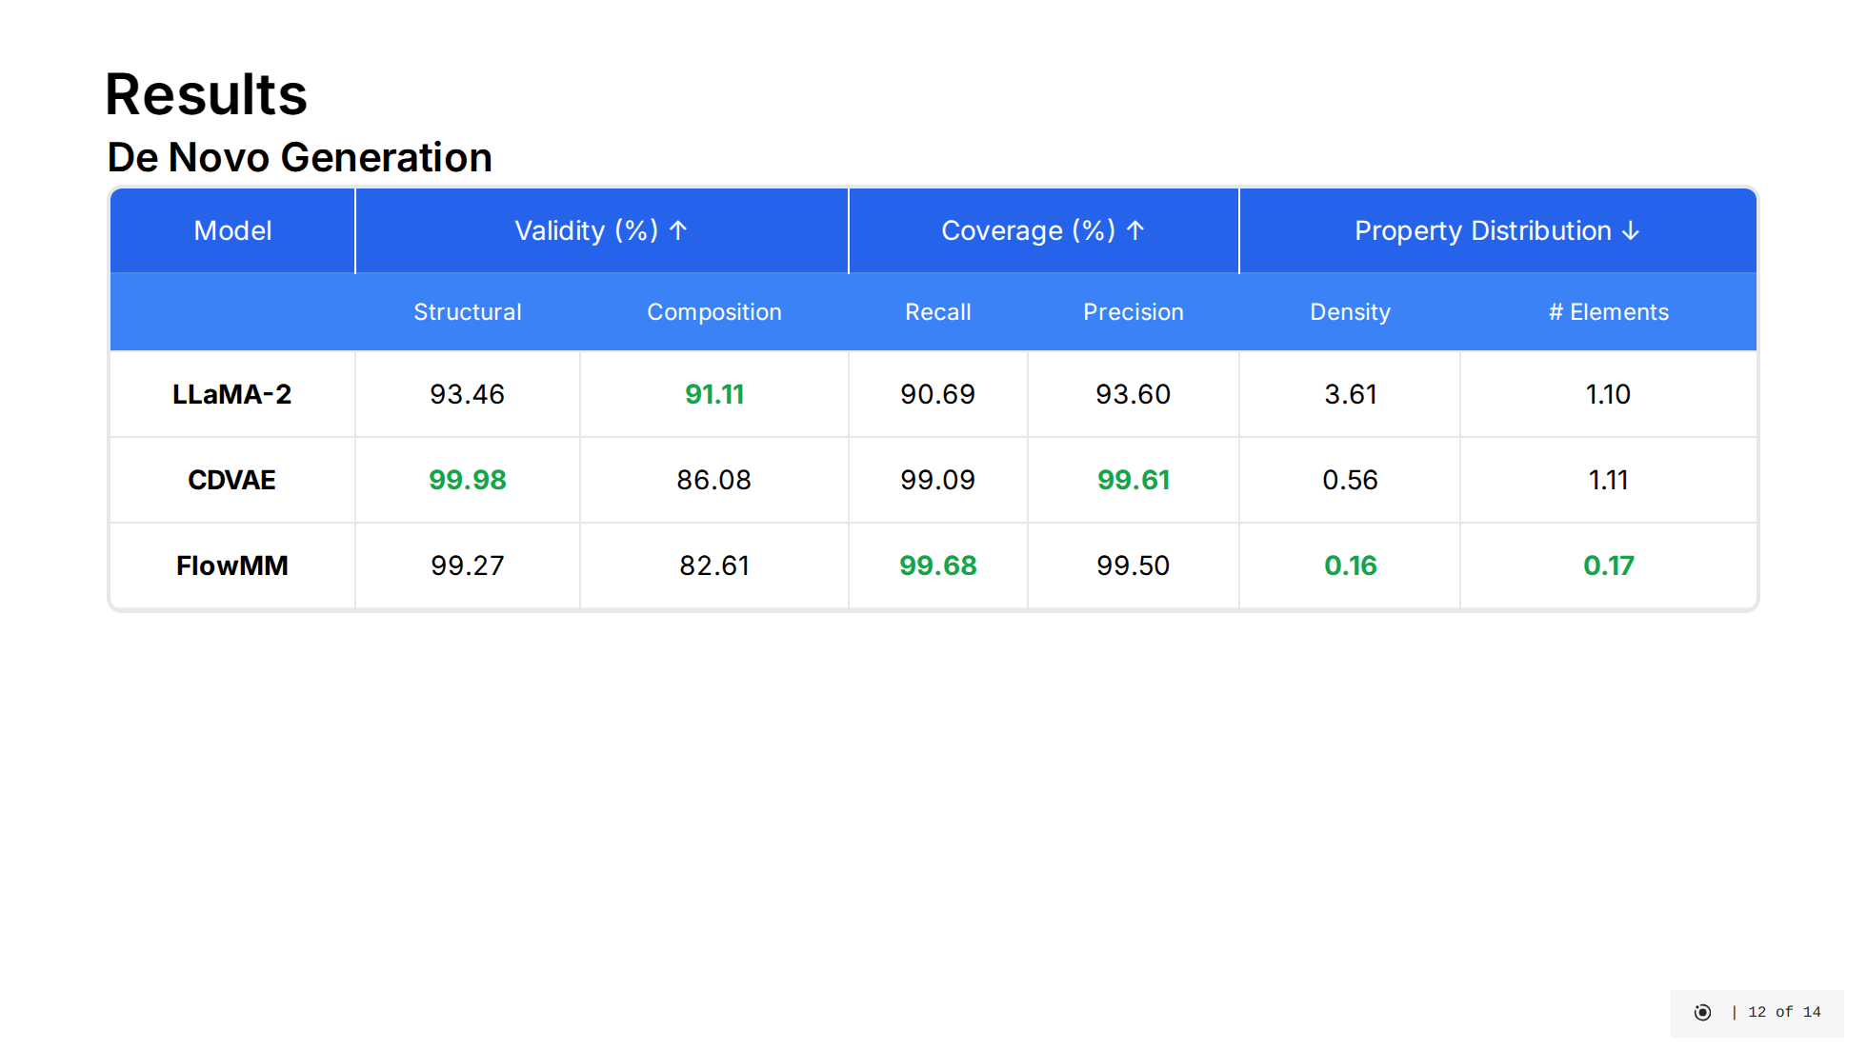
Notes:
Let's examine the performance of our three models on both generative tasks. [click] For De Novo Generation: - LLaMA-2 shows strong compositional validity at 91.11%, meaning it generates materials with appropriate charge neutrality. However, its worse coverage metrics indicates that it doesn't strictly adhere to the underlying distribution of real materials from MP-20, possibly due to its LLM pre-training. - CDVAE achieves nearly perfect structural validity at 99.98%, ensuring all generated structures have reasonable atom spacing. However, this seems to be a fairly easy task that FlowMM can match as well. CDVAE's property distribution metrics are mediocre. - FlowMM demonstrates excellent performance across most metrics. It has high structural validity, the best coverage metrics, and dramatically outperforms other models in property distribution matching. This suggests FlowMM generates materials that most closely match the statistical properties of real materials. [click] For Crystal Structure Prediction: - Here we see FlowMM dominates with both the highest match rate at 62.51% and the lowest RMSE at 0.0472. This means FlowMM is best at predicting the correct structure for a given composition and with the highest accuracy. - LLaMA-2 performs reasonably well but falls behind FlowMM, while CDVAE significantly underperforms in this task. These results suggest that flow matching's deterministic approach to learning transformations between distributions is particularly well-suited for material structure tasks, outperforming both diffusion-based approaches and large language models on most key metrics.

Slide 34
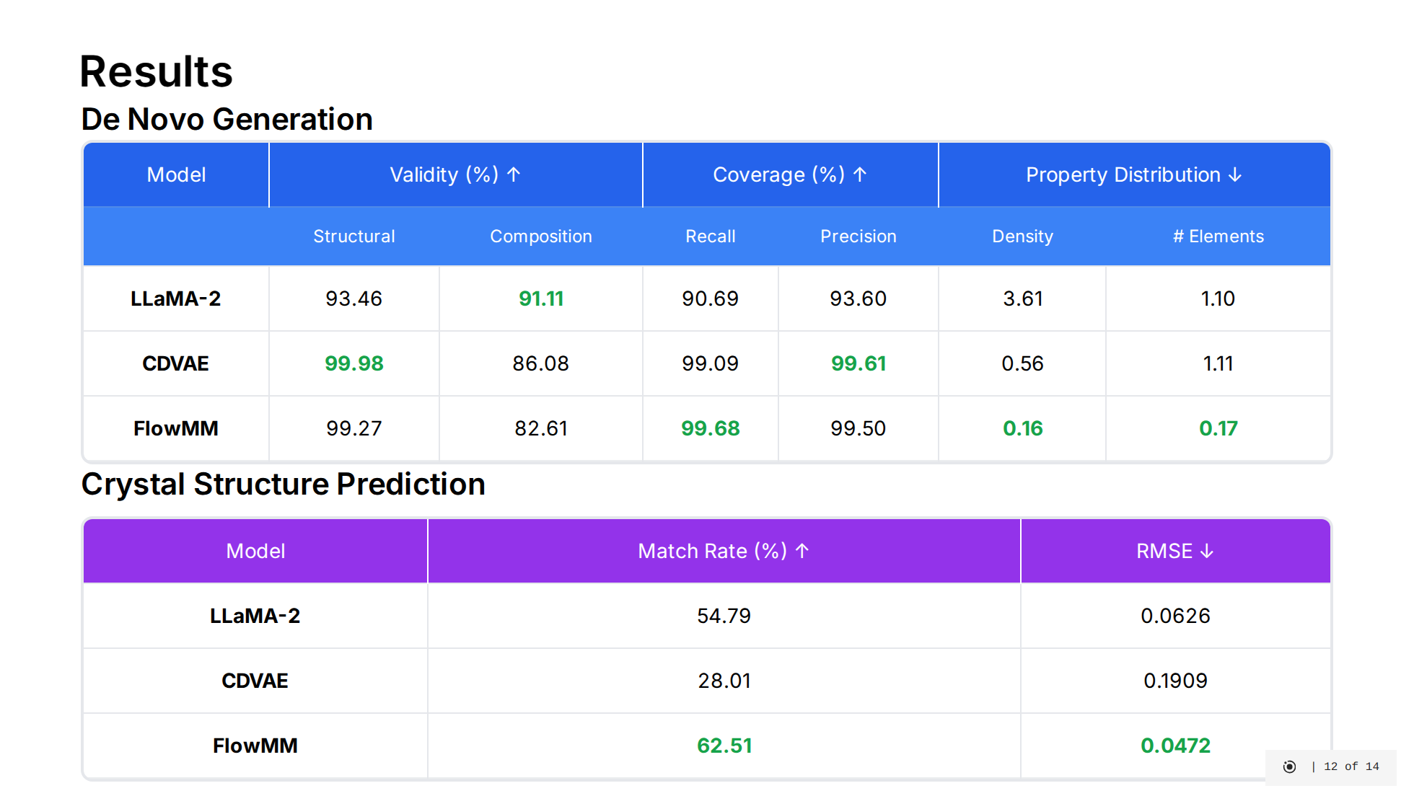
Notes:
Let's examine the performance of our three models on both generative tasks. [click] For De Novo Generation: - LLaMA-2 shows strong compositional validity at 91.11%, meaning it generates materials with appropriate charge neutrality. However, its worse coverage metrics indicates that it doesn't strictly adhere to the underlying distribution of real materials from MP-20, possibly due to its LLM pre-training. - CDVAE achieves nearly perfect structural validity at 99.98%, ensuring all generated structures have reasonable atom spacing. However, this seems to be a fairly easy task that FlowMM can match as well. CDVAE's property distribution metrics are mediocre. - FlowMM demonstrates excellent performance across most metrics. It has high structural validity, the best coverage metrics, and dramatically outperforms other models in property distribution matching. This suggests FlowMM generates materials that most closely match the statistical properties of real materials. [click] For Crystal Structure Prediction: - Here we see FlowMM dominates with both the highest match rate at 62.51% and the lowest RMSE at 0.0472. This means FlowMM is best at predicting the correct structure for a given composition and with the highest accuracy. - LLaMA-2 performs reasonably well but falls behind FlowMM, while CDVAE significantly underperforms in this task. These results suggest that flow matching's deterministic approach to learning transformations between distributions is particularly well-suited for material structure tasks, outperforming both diffusion-based approaches and large language models on most key metrics.

Slide 35
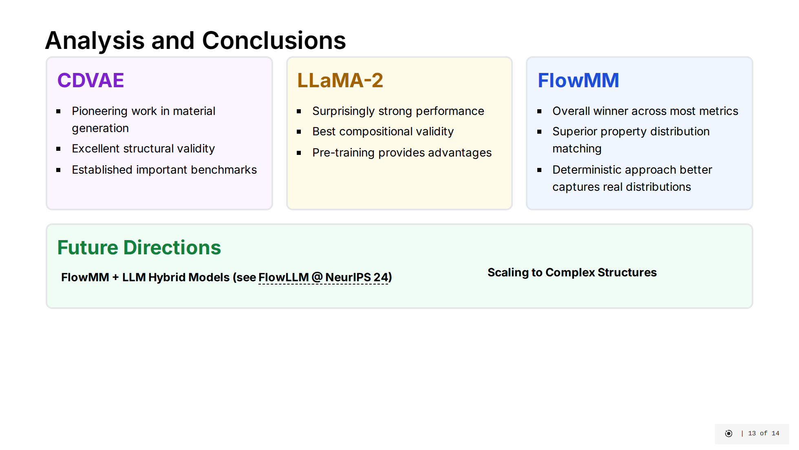
Notes:
Let's analyze what we've learned from our comparative study of these three approaches to material generation. [click] CDVAE was the pioneering work that introduced generative models to 3D material structure. It achieves nearly perfect structural validity at 99.98%, ensuring all generated structures have reasonable atom spacing. However, while it established important benchmarks for the field, it's now been surpassed by newer approaches in most metrics. [click] LLaMA-2 delivers surprisingly strong performance, particularly in compositional validity where it leads at 91.11%. This suggests that large language models contain substantial implicit knowledge about materials science, likely due to pre-training on vast repositories of scientific code and papers. This finding opens interesting avenues for leveraging LLMs in scientific domains. [click] FlowMM emerges as the clear winner across most metrics. It dominates in property distribution matching - approximately 6 times better than CDVAE on certain metrics. It also achieves both the highest match rate at 62.51% and the lowest RMSE at 0.0472 for crystal structure prediction. Its deterministic ODE-based approach seems fundamentally better suited to capturing the real distribution of materials compared to stochastic SDE-based methods. [click] Looking to the future, the most promising direction appears to be developing hybrid approaches that combine FlowMM's efficient flow matching capabilities with the vast knowledge embedded in large language models. Additionally, scaling these models to handle larger structures beyond 20 atoms per unit cell and improving compositional validity in flow-based models would further advance the field of computational materials discovery.

Slide 36
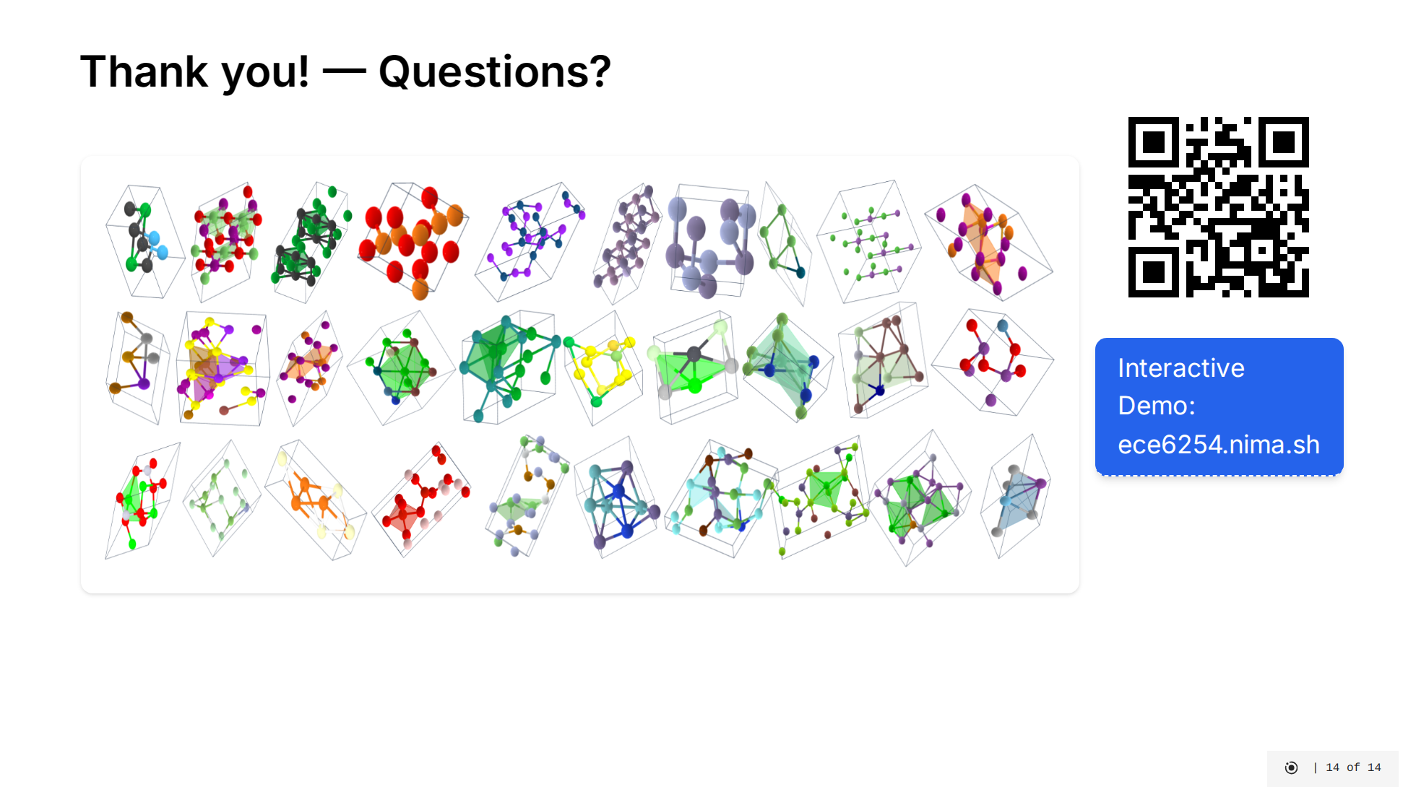
Notes:
Here we're visualizing 20,000 different material structures generated by our three models. This visualization gives us a qualitative way to compare the distribution of materials created by each approach. We extracted embeddings from all structures using a popular pre-trained model called JMP, which captures key structural and chemical features of materials. Then we projected these high-dimensional embeddings down to 2D using UMAP for visualization. Each point represents a single generated structure, and the colors indicate which model produced it. This allows us to see how the different models explore the materials space - where they overlap and where they generate unique structures. You can explore this visualization interactively by visiting our demo site or scanning the QR code. The interactive version allows you to hover over points to see the specific structures and their properties.

Slide 37
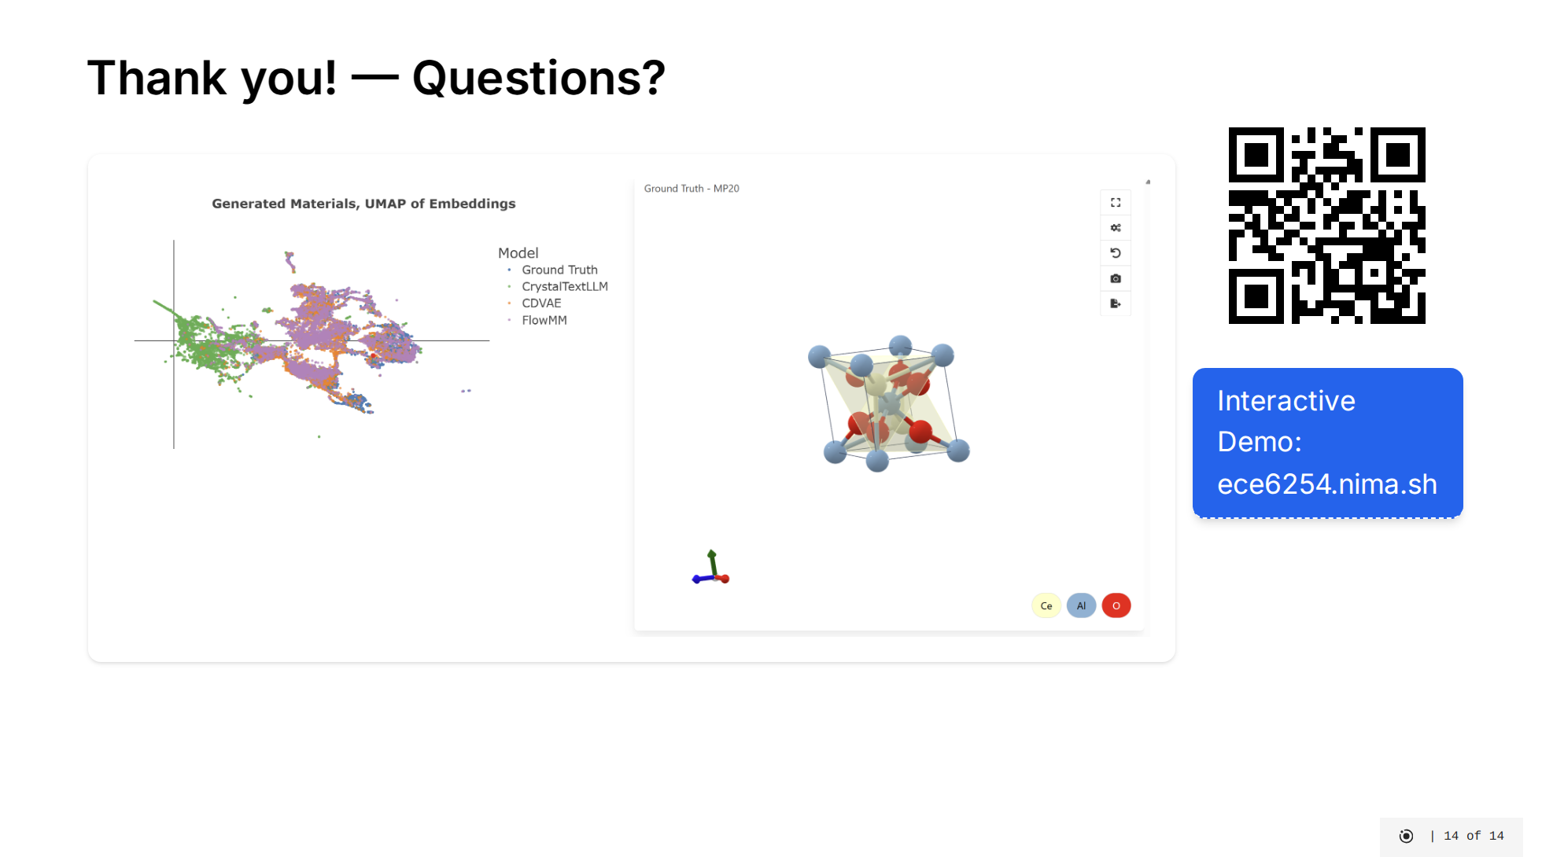
Notes:
Here we're visualizing 20,000 different material structures generated by our three models. This visualization gives us a qualitative way to compare the distribution of materials created by each approach. We extracted embeddings from all structures using a popular pre-trained model called JMP, which captures key structural and chemical features of materials. Then we projected these high-dimensional embeddings down to 2D using UMAP for visualization. Each point represents a single generated structure, and the colors indicate which model produced it. This allows us to see how the different models explore the materials space - where they overlap and where they generate unique structures. You can explore this visualization interactively by visiting our demo site or scanning the QR code. The interactive version allows you to hover over points to see the specific structures and their properties.

